Slide 1

PyTorch Introduction
A Stroll Through the Zoo of PyTorch
David Rotermund & Udo Ernst

Slide 2


PyTorch is a machine learning library based on the Torch library,[4][5][6] used for applications such as computer vision and natural language processing,[7] originally developed by Meta AI and now part of the Linux Foundation umbrella.[8][9][10][11] It is one of the most popular deep learning frameworks, alongside others such as TensorFlow,[12] offering free and open-source software released under the modified BSD license. Although the Python interface is more polished and the primary focus of development, PyTorch also has a C++ interface.[13]
A number of pieces of deep learning software are built on top of PyTorch, including Tesla Autopilot,[14] Uber's Pyro,[15] Hugging Face's Transformers,[16][17] and Catalyst.[18][19]
PyTorch provides two high-level features:[20]
Tensor computing (like NumPy) with strong acceleration via graphics processing units (GPU)
Deep neural networks built on a tape-based automatic differentiation system

Slide 3
Installing PyTorch
Check here for an installation configurator.
Windows
CPU only
pip3 install torch torchvision torchaudio torchtext
NVidia GPU
pip3 install torch torchvision torchaudio torchtext --index-url https://download.pytorch.org/whl/cu121
Linux
CPU only
cd /home/[YOURUSERNAME]/P3.12/bin
./pip3 install torch torchvision torchaudio torchtext --index-url https://download.pytorch.org/whl/cpu
NVidia GPU
cd /home/[YOURUSERNAME]/P3.12/bin
./pip3 install torch torchvision torchaudio torchtext
https://davrot.github.io/pytutorial/workflow/python_pure/

Slide 4
PyTorch Packages
Package
torch | PyTorch is a Python package that provides two high-level features: a. Tensor computation (like NumPy) with strong GPU acceleration b. Deep neural networks built on a tape-based autograd system
torchvision | The torchvision package consists of popular datasets, model architectures, and common image transformations for computer vision.
torchaudio | The aim of torchaudio is to apply PyTorch to the audio domain.
torchtext | Models, data loaders and abstractions for language processing, powered by PyTorch

Slide 5
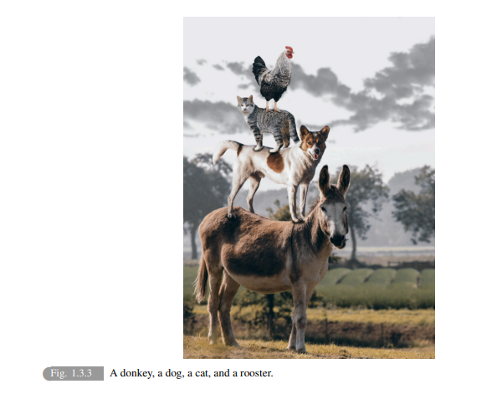
Open Book: Dive into Deep Learning
Recommendation
ASTON ZHANG
ZACHARY C. LIPTON
MU LI
ALEXANDER J. SMOLA
https://d2l.ai/d2l-en.pdf

Slide 6

Welcome to the PyTorch Zoo!
I asked our local AI to give us a tour through the PyTorch Layer Zoo....

Slide 7

Layers are the basic building blocks in PyTorch
A network is a combination of layers.
When ever we can, we should use existing layers types.
We can make our own layers.
Layers are in torch.nn. and the name of layer starts with an upper case letter.
Let us look what is available and what is relevant.

Slide 8
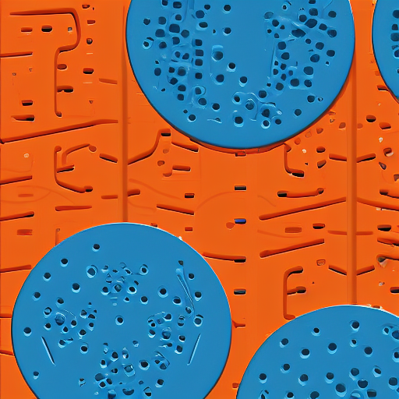
The Foundation - Module
The journey begins at the foundation of PyTorch's neural network architecture: Module. This ancestral class is the root of all layers, providing the basic structure and functionality that enables the creation of complex neural networks. Just as a strong foundation is essential for building a sturdy structure, Module lays the groundwork for the various layers and modules that follow, including linear layers, convolutional layers, and more. Explore the fundamental components of Module, such as parameters, buffers, and hooks, to understand how they facilitate the construction of diverse neural network architectures.

Slide 9
Existing layers - Containers
= relevant
Module | Base class for all neural network modules.

Slide 10
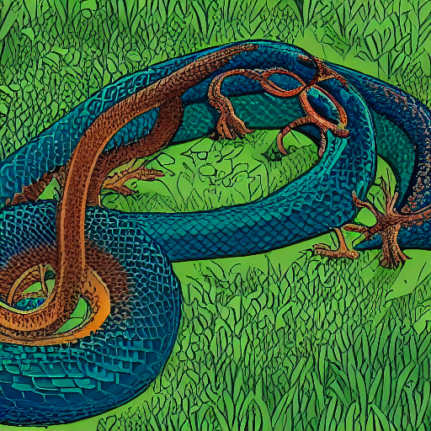
Sequential Containers - The Snake Pit
The next exhibit takes you to the Snake Pit, where a winding snake-like structure represents the concept of sequential containers in Python. Just as a snake grows and shrinks as it consumes its prey, a sequential container can dynamically add or remove elements, allowing for efficient storage and manipulation of data. Explore the different segments of the snake, each representing a single element in the container, and learn how indexing and slicing enable you to access and manipulate the data with ease.

Slide 11
Existing layers - Containers
= relevant
Sequential | A sequential container.
ModuleList | Holds submodules in a list.
ModuleDict | Holds submodules in a dictionary.
ParameterList | Holds parameters in a list.
ParameterDict | Holds parameters in a dictionary.

Slide 12
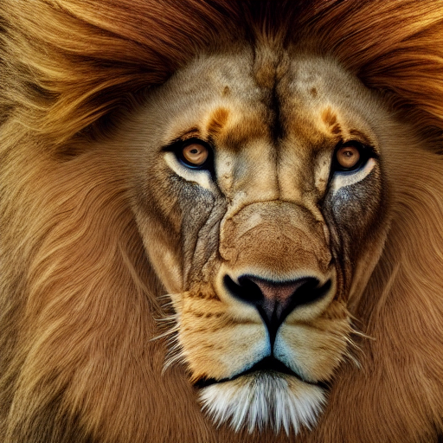
Linear Layer - The Lion
The first exhibit features the Linear Layer, represented by a regal lion. Just as a lion's mane connects its head to its body, the Linear Layer connects every input to every output. The lion's strength and agility symbolize the layer's ability to tackle complex tasks.

Slide 13
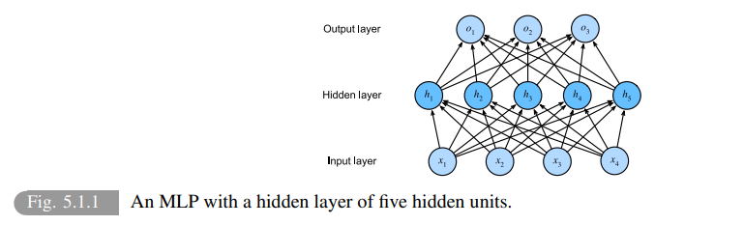
From “Dive into Deep Learning”

Slide 14
Existing layers - Linear Layers
= relevant
torch.nn.Identity | A placeholder identity operator that is argument-insensitive
torch.nn.Linear | Applies a linear transformation to the incoming data
torch.nn.Bilinear | Applies a bilinear transformation to the incoming data
torch.nn.LazyLinear | A torch.nn.Linear module where in_features is inferred.

Slide 15
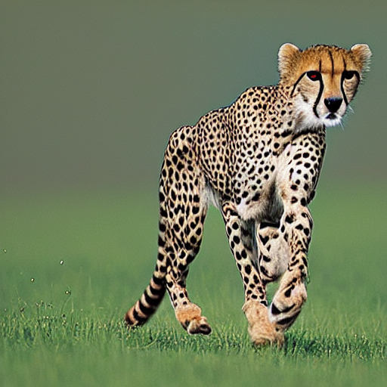
Convolutional Layer - The Cheetah
Next, you'll visit the Convolutional Layer exhibit, featuring a swift cheetah. The cheetah's speed and agility represent the layer's ability to quickly scan and process data, using filters to extract features like a cheetah uses its speed to catch prey.

Slide 16
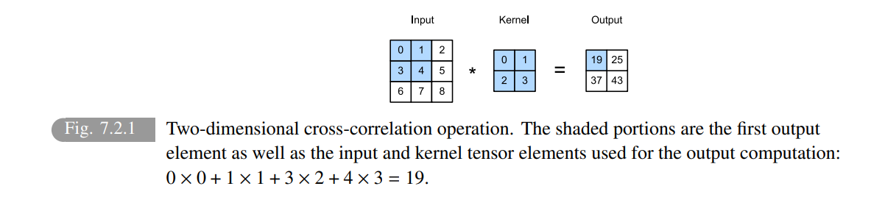
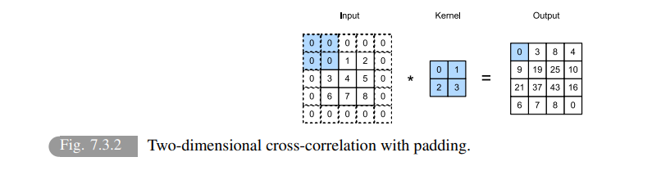
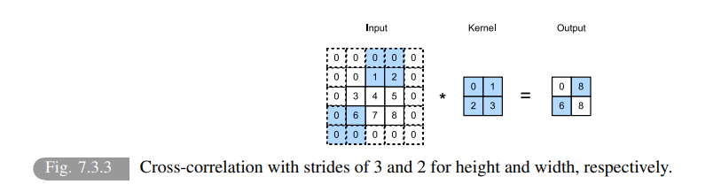
From “Dive into Deep Learning”

Slide 17
Existing layers - Convolution Layers
= relevant
torch.nn.Conv1d | Applies a 1D convolution over an input signal composed of several input planes.
torch.nn.Conv2d | Applies a 2D convolution over an input signal composed of several input planes.
torch.nn.Conv3d | Applies a 3D convolution over an input signal composed of several input planes.
torch.nn.ConvTranspose1d | Applies a 1D transposed convolution operator over an input image composed of several input planes.
torch.nn.ConvTranspose2d | Applies a 2D transposed convolution operator over an input image composed of several input planes.
torch.nn.ConvTranspose3d | Applies a 3D transposed convolution operator over an input image composed of several input planes.
torch.nn.LazyConv1d | A torch.nn.Conv1d module with lazy initialization of the in_channels argument of the Conv1d that is inferred from the input.size(1).
torch.nn.LazyConv2d | A torch.nn.Conv2d module with lazy initialization of the in_channels argument of the Conv2d that is inferred from the input.size(1).
torch.nn.LazyConv3d | A torch.nn.Conv3d module with lazy initialization of the in_channels argument of the Conv3d that is inferred from the input.size(1).
torch.nn.LazyConvTranspose1d | A torch.nn.ConvTranspose1d module with lazy initialization of the in_channels argument of the ConvTranspose1d that is inferred from the input.size(1).
torch.nn.LazyConvTranspose2d | A torch.nn.ConvTranspose2d module with lazy initialization of the in_channels argument of the ConvTranspose2d that is inferred from the input.size(1).
torch.nn.LazyConvTranspose3d | A torch.nn.ConvTranspose3d module with lazy initialization of the in_channels argument of the ConvTranspose3d that is inferred from the input.size(1).
torch.nn.Unfold | Extracts sliding local blocks from a batched input tensor.
torch.nn.Fold | Combines an array of sliding local blocks into a large containing tensor.
I use those for my spiking convolution networks

Slide 18

Pooling Layers - The Koi Pond
The Pooling Layer is represented by a serene koi pond, where fish swim together in harmony. Just as the fish reduce the complexity of the water's surface by swimming in schools, the Pooling Layer reduces the spatial dimensions of the input data, helping the model to focus on the most important features.

Slide 19
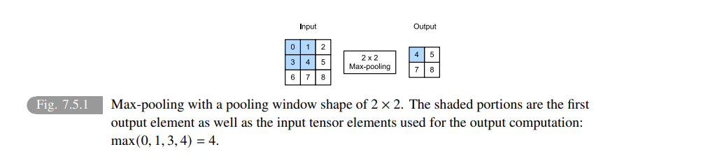
From “Dive into Deep Learning”

Slide 20
Existing layers - Pooling layers
= relevant
torch.nn.MaxPool1d | Applies a 1D max pooling over an input signal composed of several input planes.
torch.nn.MaxPool2d | Applies a 2D max pooling over an input signal composed of several input planes.
torch.nn.MaxPool3d | Applies a 3D max pooling over an input signal composed of several input planes.
torch.nn.MaxUnpool1d | Computes a partial inverse of MaxPool1d.
torch.nn.MaxUnpool2d | Computes a partial inverse of MaxPool2d.
torch.nn.MaxUnpool3d | Computes a partial inverse of MaxPool3d.
torch.nn.AvgPool1d | Applies a 1D average pooling over an input signal composed of several input planes.
torch.nn.AvgPool2d | Applies a 2D average pooling over an input signal composed of several input planes.
torch.nn.AvgPool3d | Applies a 3D average pooling over an input signal composed of several input planes.
torch.nn.FractionalMaxPool2d | Applies a 2D fractional max pooling over an input signal composed of several input planes.
torch.nn.FractionalMaxPool3d | Applies a 3D fractional max pooling over an input signal composed of several input planes.
torch.nn.LPPool1d | Applies a 1D power-average pooling over an input signal composed of several input planes.
torch.nn.LPPool2d | Applies a 2D power-average pooling over an input signal composed of several input planes.
torch.nn.AdaptiveMaxPool1d | Applies a 1D adaptive max pooling over an input signal composed of several input planes.
torch.nn.AdaptiveMaxPool2d | Applies a 2D adaptive max pooling over an input signal composed of several input planes.
torch.nn.AdaptiveMaxPool3d | Applies a 3D adaptive max pooling over an input signal composed of several input planes.
torch.nn.AdaptiveAvgPool1d | Applies a 1D adaptive average pooling over an input signal composed of several input planes.
torch.nn.AdaptiveAvgPool2d | Applies a 2D adaptive average pooling over an input signal composed of several input planes.
torch.nn.AdaptiveAvgPool3d | Applies a 3D adaptive average pooling over an input signal composed of several input planes.

Slide 21
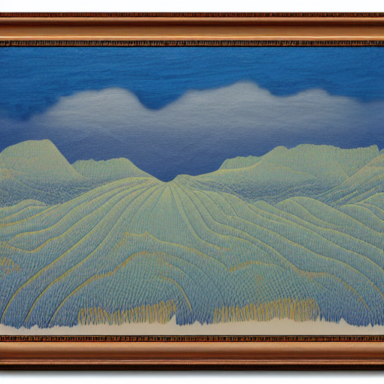
Padding Layers - The Framed Artwork
The Padding Layer is represented by a beautifully framed artwork, where a delicate border surrounds a stunning painting. Just as the frame enhances and protects the artwork, the Padding Layer adds zeros to the input data, helping to preserve important information at the borders and improving model performance.

Slide 22
Existing layers - Padding Layers
= relevant
torch.nn.ReflectionPad1d | Pads the input tensor using the reflection of the input boundary.
torch.nn.ReflectionPad2d | Pads the input tensor using the reflection of the input boundary.
torch.nn.ReflectionPad3d | Pads the input tensor using the reflection of the input boundary.
torch.nn.ReplicationPad1d | Pads the input tensor using replication of the input boundary.
torch.nn.ReplicationPad2d | Pads the input tensor using replication of the input boundary.
torch.nn.ReplicationPad3d | Pads the input tensor using replication of the input boundary.
torch.nn.ZeroPad1d | Pads the input tensor boundaries with zero.
torch.nn.ZeroPad2d | Pads the input tensor boundaries with zero.
torch.nn.ZeroPad3d | Pads the input tensor boundaries with zero.
torch.nn.ConstantPad1d | Pads the input tensor boundaries with a constant value.
torch.nn.ConstantPad2d | Pads the input tensor boundaries with a constant value.
torch.nn.ConstantPad3d | Pads the input tensor boundaries with a constant value.

Slide 23

Activation Function Layers - The Butterfly Garden
The final exhibit features a beautiful butterfly garden, representing the various activation functions like ReLU, Sigmoid, and Tanh. Just as different butterflies have unique characteristics and behaviors, each activation function introduces non-linearity into the model in its own way, allowing it to learn complex patterns.

Slide 24
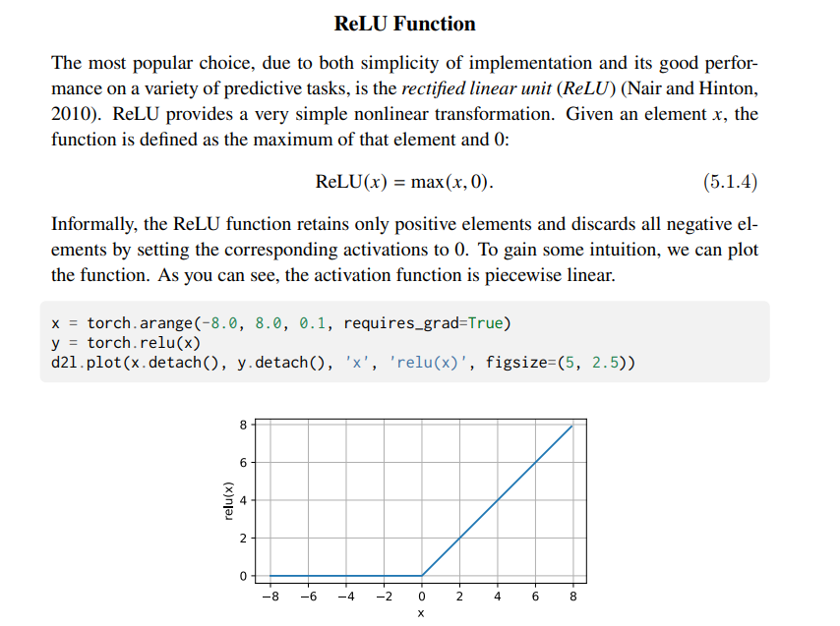
From “Dive into Deep Learning”

Slide 25
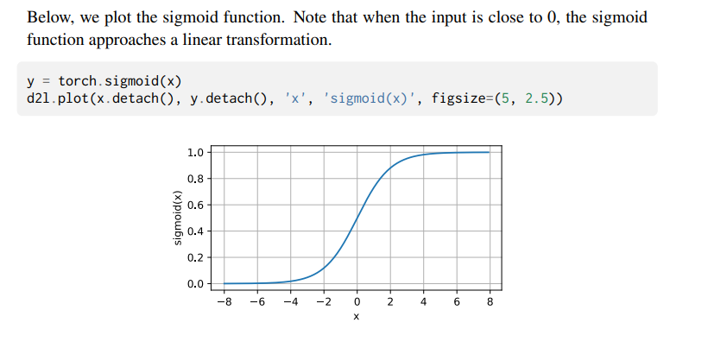
From “Dive into Deep Learning”

Slide 26
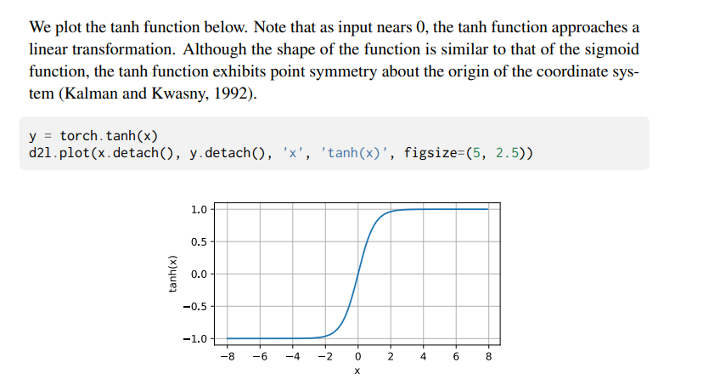
From “Dive into Deep Learning”

Slide 27
Existing layers - Non-linear Activations (weighted sum, nonlinearity)
= relevant
torch.nn.ELU | Applies the Exponential Linear Unit (ELU) function, element-wise, as described in the paper: Fast and Accurate Deep Network Learning by Exponential Linear Units (ELUs).
torch.nn.Hardshrink | Applies the Hard Shrinkage (Hardshrink) function element-wise.
torch.nn.Hardsigmoid | Applies the Hardsigmoid function element-wise.
torch.nn.Hardtanh | Applies the HardTanh function element-wise.
torch.nn.Hardswish | Applies the Hardswish function, element-wise, as described in the paper: Searching for MobileNetV3.
torch.nn.LeakyReLU | Applies the element-wise function:
torch.nn.LogSigmoid | Applies the element-wise function:
torch.nn.MultiheadAttention | Allows the model to jointly attend to information from different representation subspaces as described in the paper: Attention Is All You Need.
torch.nn.PReLU | Applies the element-wise function:
torch.nn.ReLU | Applies the rectified linear unit function element-wise:
torch.nn.ReLU6 | Applies the element-wise function:
torch.nn.RReLU | Applies the randomized leaky rectified liner unit function, element-wise, as described in the paper:
torch.nn.SELU | Applied element-wise…
torch.nn.CELU | Applies the element-wise function…
torch.nn.GELU | Applies the Gaussian Error Linear Units function:

Slide 28
Existing layers - Non-linear Activations (weighted sum, nonlinearity)
= relevant
torch.nn.Sigmoid | Applies the element-wise function:…
torch.nn.SiLU | Applies the Sigmoid Linear Unit (SiLU) function, element-wise.
torch.nn.Mish | Applies the Mish function, element-wise.
torch.nn.Softplus | Applies the Softplus function
torch.nn.Softshrink | Applies the soft shrinkage function elementwise:
torch.nn.Softsign | Applies the element-wise function:…
torch.nn.Tanh | Applies the Hyperbolic Tangent (Tanh) function element-wise.
torch.nn.Tanhshrink | Applies the element-wise function:
torch.nn.Threshold | Thresholds each element of the input Tensor.
torch.nn.GLU | Applies the gated linear unit function

Slide 29
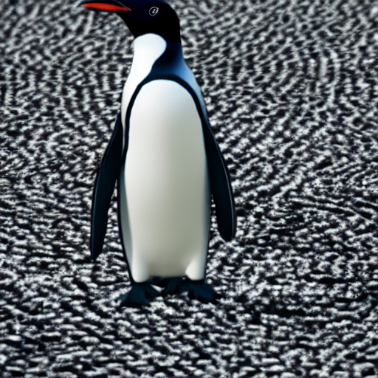
Batch Normalization Layer - The Penguin
The Batch Normalization Layer is depicted as a penguin, which thrives in groups and follows norms. The layer normalizes the input data for each mini-batch, ensuring that all the inputs follow the same distribution and improving model stability.

Slide 30
Existing layers - Normalization Layers
= relevant
torch.nn.BatchNorm1d | Applies Batch Normalization over a 2D or 3D input as described in the paper Batch Normalization: Accelerating Deep Network Training by Reducing Internal Covariate Shift .
torch.nn.BatchNorm2d | Applies Batch Normalization over a 4D input (a mini-batch of 2D inputs with additional channel dimension) as described in the paper Batch Normalization: Accelerating Deep Network Training by Reducing Internal Covariate Shift .
torch.nn.BatchNorm3d | Applies Batch Normalization over a 5D input (a mini-batch of 3D inputs with additional channel dimension) as described in the paper Batch Normalization: Accelerating Deep Network Training by Reducing Internal Covariate Shift .
torch.nn.LazyBatchNorm1d | A torch.nn.BatchNorm1d module with lazy initialization of the num_features argument of the BatchNorm1d that is inferred from the input.size(1).
torch.nn.LazyBatchNorm2d | A torch.nn.BatchNorm2d module with lazy initialization of the num_features argument of the BatchNorm2d that is inferred from the input.size(1).
torch.nn.LazyBatchNorm3d | A torch.nn.BatchNorm3d module with lazy initialization of the num_features argument of the BatchNorm3d that is inferred from the input.size(1).
torch.nn.GroupNorm | Applies Group Normalization over a mini-batch of inputs as described in the paper Group Normalization
torch.nn.SyncBatchNorm | Applies Batch Normalization over a N-Dimensional input (a mini-batch of [N-2]D inputs with additional channel dimension) as described in the paper Batch Normalization: Accelerating Deep Network Training by Reducing Internal Covariate Shift .
torch.nn.InstanceNorm1d | Applies Instance Normalization over a 2D (unbatched) or 3D (batched) input as described in the paper Instance Normalization: The Missing Ingredient for Fast Stylization.
torch.nn.InstanceNorm2d | Applies Instance Normalization over a 4D input (a mini-batch of 2D inputs with additional channel dimension) as described in the paper Instance Normalization: The Missing Ingredient for Fast Stylization.
torch.nn.InstanceNorm3d | Applies Instance Normalization over a 5D input (a mini-batch of 3D inputs with additional channel dimension) as described in the paper Instance Normalization: The Missing Ingredient for Fast Stylization.
torch.nn.LazyInstanceNorm1d | A torch.nn.InstanceNorm1d module with lazy initialization of the num_features argument of the InstanceNorm1d that is inferred from the input.size(1).
torch.nn.LazyInstanceNorm2d | A torch.nn.InstanceNorm2d module with lazy initialization of the num_features argument of the InstanceNorm2d that is inferred from the input.size(1).
torch.nn.LazyInstanceNorm3d | A torch.nn.InstanceNorm3d module with lazy initialization of the num_features argument of the InstanceNorm3d that is inferred from the input.size(1).
torch.nn.LayerNorm | Applies Layer Normalization over a mini-batch of inputs as described in the paper Layer Normalization
torch.nn.LocalResponseNorm | Applies local response normalization over an input signal composed of several input planes, where channels occupy the second dimension.

Slide 31
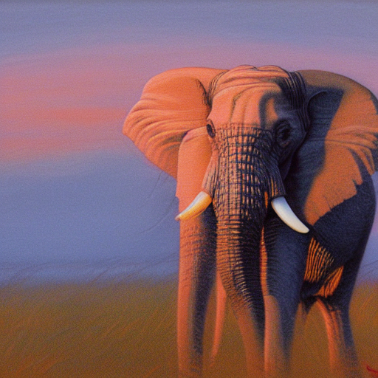
Recurrent Neural Network (RNN) Layer - The Elephant
The RNN Layer is depicted as an elephant, with its excellent memory and ability to recall past experiences. Just as an elephant never forgets, the RNN Layer uses feedback connections to keep track of information over time, making it perfect for sequential data.

Slide 32
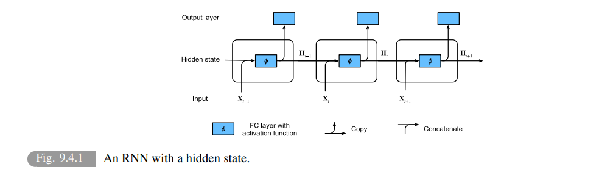
From “Dive into Deep Learning”

Slide 33
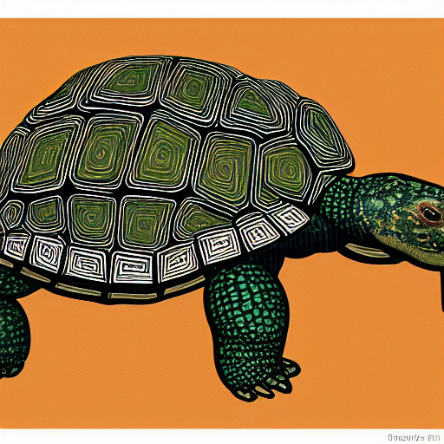
Long Short-Term Memory (LSTM) Layer - The Tortoise
The LSTM Layer is represented by a tortoise, symbolizing its ability to carry information over long distances and remember it for extended periods. The tortoise's shell protects it from the outside world, just as the LSTM Layer's memory cells and gates protect the information from vanishing.

Slide 34
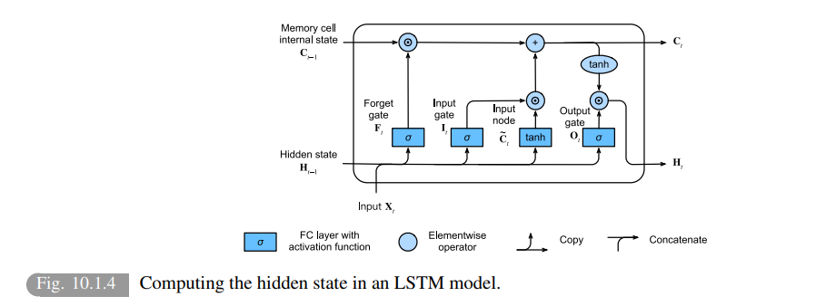
From “Dive into Deep Learning”

Slide 35
Existing layers - Recurrent Layers
= relevant
RNN, GRU, LSTM and such lives here.
If you don’t know what this means then you don’t need them… It is for modelling time series.
torch.nn.RNNBase | Base class for RNN modules (RNN, LSTM, GRU).
torch.nn.RNN | Applies a multi-layer Elman
torch.nn.LSTM | Applies a multi-layer long short-term memory (LSTM) RNN to an input sequence.
torch.nn.GRU | Applies a multi-layer gated recurrent unit (GRU) RNN to an input sequence.
torch.nn.RNNCell | An Elman RNN cell with tanh or ReLU non-linearity.
torch.nn.LSTMCell | A long short-term memory (LSTM) cell.
torch.nn.GRUCell | A gated recurrent unit (GRU) cell

Slide 36

Transformer Layer - The Parrot
The Transformer Layer is depicted as a colorful parrot, known for its ability to mimic and understand context. The parrot's self-attention mechanisms allow it to weigh the importance of different input elements, just like a parrot weighs the importance of different sounds and words.

Slide 37
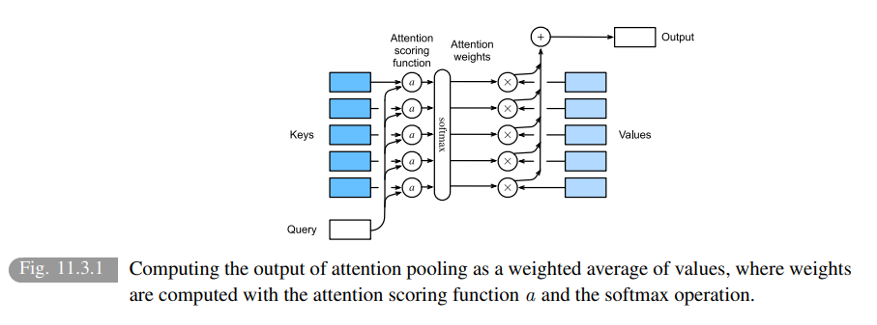

From “Dive into Deep Learning”

Slide 38
Existing layers - Transformer Layers
If you do research on transformers or want to use them then you will write them yourself.
torch.nn.Transformer | A transformer model.
torch.nn.TransformerEncoder | TransformerEncoder is a stack of N encoder layers.
torch.nn.TransformerDecoder | TransformerDecoder is a stack of N decoder layers
torch.nn.TransformerEncoderLayer | TransformerEncoderLayer is made up of self-attn and feedforward network.
torch.nn.TransformerDecoderLayer | TransformerDecoderLayer is made up of self-attn, multi-head-attn and feedforward network.

Slide 39
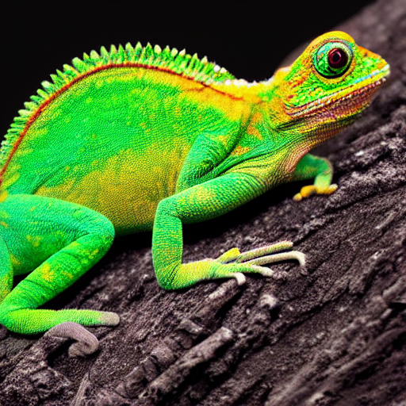
Dropout Layer - The Chameleon
The Dropout Layer is represented by a chameleon, which can change its appearance to adapt to its surroundings. The Dropout Layer randomly sets a fraction of the output elements to zero during training, allowing the model to adapt and prevent overfitting.

Slide 40
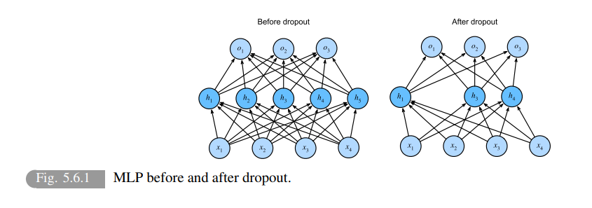
From “Dive into Deep Learning”

Slide 41
Existing layers - Dropout Layers
= relevant
torch.nn.Dropout | During training, randomly zeroes some of the elements of the input tensor with probability p using samples from a Bernoulli distribution.
torch.nn.Dropout1d | Randomly zero out entire channels (a channel is a 1D feature map).
torch.nn.Dropout2d | Randomly zero out entire channels (a channel is a 2D feature map).
torch.nn.Dropout3d | Randomly zero out entire channels (a channel is a 3D feature map)
torch.nn.AlphaDropout | Applies Alpha Dropout over the input.
torch.nn.FeatureAlphaDropout | Randomly masks out entire channels (a channel is a feature map)

Slide 42

Sparse Layers - The Desert Landscape
The Sparse Layer is represented by a vast and arid desert landscape, where cacti and succulents thrive in the harsh environment. Just as these plants have adapted to survive with limited resources, the Sparse Layer helps the model to focus on the most important features of the input data, eliminating unnecessary connections and improving efficiency.

Slide 43
Existing layers - Sparse Layers
torch.nn.Embedding | A simple lookup table that stores embeddings of a fixed dictionary and size.
torch.nn.EmbeddingBag | Computes sums or means of ‘bags’ of embeddings, without instantiating the intermediate embeddings.

Slide 44

Distance Functions - The Map Room
The Distance Function is represented by a map room, where cartographers measure distances between different locations. Just as the cartographers use various distance metrics to calculate the shortest path, the Distance Function measures the similarity or dissimilarity between input data points, helping the model to make predictions and classify examples.

Slide 45
Existing layers - Distance Functions
torch.nn.CosineSimilarity | Returns cosine similarity
torch.nn.PairwiseDistance | Computes the pairwise distance between input vectors, or between columns of input matrices.

Slide 46
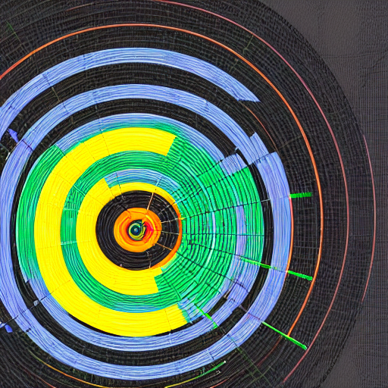
Loss Functions - The Target Practice Range
The Loss Function is represented by a target practice range, where archers aim to hit the bullseye. Just as the archers strive to minimize their distance from the target, the Loss Function measures the difference between the model's predictions and the actual labels, helping the model to learn and improve.

Slide 47
Existing layers - Loss Functions
= relevant
torch.nn.L1Loss | Creates a criterion that measures the mean absolute error (MAE) between each element in the input
torch.nn.MSELoss | Creates a criterion that measures the mean squared error (squared L2 norm) between each element in the input
torch.nn.CrossEntropyLoss | This criterion computes the cross entropy loss between input logits and target.
torch.nn.CTCLoss | The Connectionist Temporal Classification loss.
torch.nn.NLLLoss | The negative log likelihood loss.
torch.nn.PoissonNLLLoss | Negative log likelihood loss with Poisson distribution of target.
torch.nn.GaussianNLLLoss | Gaussian negative log likelihood loss.
torch.nn.KLDivLoss | The Kullback-Leibler divergence loss.
torch.nn.BCELoss | Creates a criterion that measures the Binary Cross Entropy between the target and the input probabilities:
torch.nn.BCEWithLogitsLoss | This loss combines a Sigmoid layer and the BCELoss in one single class.
torch.nn.MarginRankingLoss | Creates a criterion that measures the loss
torch.nn.HingeEmbeddingLoss | Measures the loss given an input tensor
torch.nn.MultiLabelMarginLoss | Creates a criterion that optimizes a multi-class multi-classification hinge loss (margin-based loss)
torch.nn.HuberLoss | Creates a criterion that uses a squared term if the absolute element-wise error falls below delta and a delta-scaled L1 term otherwise.
torch.nn.SmoothL1Loss | Creates a criterion that uses a squared term if the absolute element-wise error falls below beta and an L1 term otherwise.
torch.nn.SoftMarginLoss | Creates a criterion that optimizes a two-class classification logistic loss
torch.nn.MultiLabelSoftMarginLoss | Creates a criterion that optimizes a multi-label one-versus-all loss based on max-entropy
torch.nn.CosineEmbeddingLoss | Creates a criterion that measures the loss given input tensors and a Tensor label
torch.nn.MultiMarginLoss | Creates a criterion that optimizes a multi-class classification hinge loss (margin-based loss)
torch.nn.TripletMarginLoss | Creates a criterion that measures the triplet loss given an input tensors
torch.nn.TripletMarginWithDistanceLoss | Creates a criterion that measures the triplet loss given input tensors

Slide 48
Existing layers - Utilities
= relevant
In this category you will find a lot of utility functions…
A lot!
torch.nn.Flatten | Flattens a contiguous range of dims into a tensor.
torch.nn.Unflatten | Unflattens a tensor dim expanding it to a desired shape.
Quantization
The probability that you need it is low but I listed it here because we are working on it.
And if I need to find the link…
I will skip the following layer types (because you will not care about them):
Sparse Layers
Vision Layers
Shuffle Layers
DataParallel Layers (multi-GPU, distributed)

Slide 49
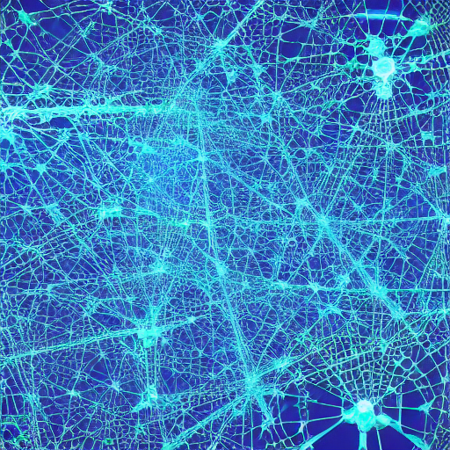
Leaving the PyTorch zoo
Our local AI says:
It was fun exploring the world of PyTorch with you! As we leave the zoo, I hope you had a wild time learning about the different stops, from torch.nn.Module to various layers and modules.
Thanks for chatting with me! If you have any more questions or want to explore more topics, feel free to ask me anytime. Have a great day!
Not so fast... Here the story really starts for us!

