Slide 1

PyTorch Introduction
Tensors et al.
David Rotermund & Udo Ernst

Slide 2
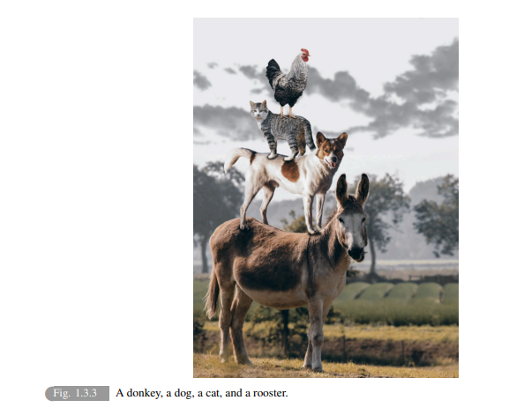
Open Book: Dive into Deep Learning
Recommendation
ASTON ZHANG
ZACHARY C. LIPTON
MU LI
ALEXANDER J. SMOLA
https://d2l.ai/d2l-en.pdf

Slide 3
Anatomy of a PyTorch Network + Support
Training of the weights
Target
Output
Loss function
Layer N
Optimizer
Learning Rate
Scheduler
Layer 2
Layer 1
Dataloader
Network
(torch.nn.sequential)

Slide 4
Anatomy of a PyTorch Network + Support
Inference
Output
Layer N
Layer 2
Layer 1
Dataloader
Network
(torch.nn.sequential)

Slide 5
torch.tensor is the numpy.ndarray of PyTorch
== torch.tensor
== stored data

Slide 6
Torch.tensor

Slide 7
Numpy to torch.tensor
torch.tensor(data, *, dtype=None, device=None, requires_grad=False, pin_memory=False) → Tensor
import numpy as np
import torch
a_np: np.ndarray = np.zeros((10, 10))
a_torch: torch.Tensor = torch.tensor(a_np)
print(type(a_torch)) # <class 'torch.Tensor'>
!
A torch tensor is of the class torch.Tensor
Be aware of the large T if you use type annotation.

Slide 8
Torch.Tensor to Numpy
remove any gradient data if the tensor has some torch.Tensor.detach
bring the data to the CPU if it not already on the CPU. torch.Tensor.cpu
convert to numpy torch.Tensor.numpy
import numpy as np
import torch
a_torch: torch.Tensor = torch.zeros((10, 10))
a_np: np.ndarray = a_torch.detach().cpu().numpy()
print(type(a_np)) # <class 'numpy.ndarray'>

Slide 9
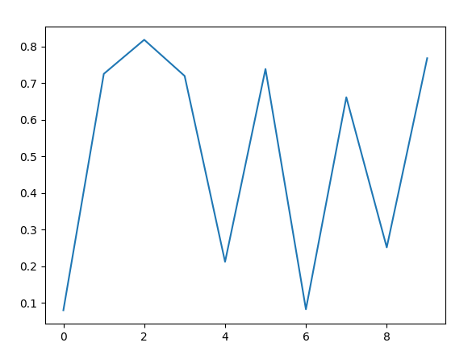
Torch.Tensor to Numpy
However, there are some best case scenarios...
import matplotlib.pyplot as plt
import torch
a_torch: torch.Tensor = torch.rand((10,))
plt.plot(a_torch)
plt.show()

Slide 10
Matrix generation
torch.zeros
torch.zeros(*size, *, out=None, dtype=None, layout=torch.strided, device=None, requires_grad=False) → Tensor
torch.zeros_like
torch.zeros_like(input, *, dtype=None, layout=None, device=None, requires_grad=False, memory_format=torch.preserve_format) → Tensor
torch.ones | torch.ones_like
torch.empty | torch.empty_like
torch.full | torch.full_like

Slide 11
Random sampling
(examples)
seed | Sets the seed for generating random numbers to a non-deterministic random number on all devices.
bernoulli | Draws binary random numbers (0 or 1) from a Bernoulli distribution.
multinomial | Returns a tensor where each row contains num_samples indices sampled from the multinomial probability distribution located in the corresponding row of tensor input.
normal | Returns a tensor of random numbers drawn from separate normal distributions whose mean and standard deviation are given.
poisson | Returns a tensor of the same size as input with each element sampled from a Poisson distribution with rate parameter
rand | Returns a tensor filled with random numbers from a uniform distribution on the interval [0,1)
randint | Returns a tensor filled with random integers generated uniformly between low (inclusive) and high (exclusive).
randn | Returns a tensor with the same size as input that is filled with random numbers from a normal distribution with mean 0 and variance 1.
randperm | Returns a random permutation of integers from 0 to n - 1.

Slide 12
Math operations
Constants (inf, nan)
Pointwise Ops (abs, acos, exp, log, ...)
Reduction Ops (argmax, min, max, mean, nanmean, var, ...)
Comparison Ops (isfinite, sort, le, ge, ...)
Spectral Ops
Other Operations (clone, corrcoef, cumsum, diff, flip, histc, ...)
BLAS and LAPACK Operations (bmm, inverse, svd, trapezoid, ...)
Foreach Operations
At some point you want to scroll through the list...

Slide 13
Close to numpy.ndarray but not the same

Slide 14
Close to numpy.ndarray but not the same
Replace:
axis —> dim
keepdims —> keepdim
Example: max()
numpy.max(a, axis=None, out=None, keepdims=<no value>, initial=<no value>, where=<no value>)
—>
torch.max(input, dim, keepdim=False, *, out=None)

Slide 15
Dimensions: remove
Squeeze
torch.squeeze(input: Tensor, dim: Optional[Union[int, List[int]]]) → Tensor
“Returns a tensor with all specified dimensions of input of size 1 removed.”
x = torch.zeros(2, 1, 2, 1, 2)
x.size() # torch.Size([2, 1, 2, 1, 2])
y = torch.squeeze(x)
y.size() # torch.Size([2, 2, 2])

Slide 16
Dimensions: add
Unsqueeze
torch.unsqueeze(input, dim) → Tensor
“Returns a new tensor with a dimension of size one inserted at the specified position.”
x = torch.tensor([1, 2, 3, 4])
torch.unsqueeze(x, 0) # tensor([[ 1, 2, 3, 4]])
torch.unsqueeze(x, 1) # tensor([[ 1], [ 2], [ 3], [ 4]])

Slide 17
Copy is clone
torch.clone(input, *, memory_format=torch.preserve_format) → Tensor
Tensor.clone(*, memory_format=torch.preserve_format) → Tensor
!
Don’t forget to .detach() first and then .clone() otherwise you copy the gradients too.

Slide 18
Load / Save
torch.load(f, map_location=None, pickle_module=pickle, *, weights_only=True, mmap=None, **pickle_load_args)
torch.save(obj, f, pickle_module=pickle, pickle_protocol=2, _use_new_zipfile_serialization=True)
import torch
a_torch: torch.Tensor = torch.rand((10,))
torch.save(a_torch, "test_file.pt")
b_torch = torch.load("test_file.pt", weights_only=False)
print(type(b_torch)) # <class 'torch.Tensor'>
print(b_torch.shape) # torch.Size([10])
weights_only is a topic for saving networks. Here define whatever we want but we need to define something to make torch to be silent.

Slide 19
torch.mm (@) vs torch.bmm
torch.mm(input, mat2, *, out=None) → Tensor
“Performs a matrix multiplication of the matrices input and mat2.
If input is a (n×m) tensor, mat2 is a (m×p) tensor, out will be a (n×p) tensor.”
torch.bmm(input, mat2, *, out=None) → Tensor
“Performs a batch matrix-matrix product of matrices stored in input and mat2.
input and mat2 must be 3-D tensors each containing the same number of matrices.
If input is a (b×n×m) tensor, mat2 is a (b×m×p) tensor, out will be a (b×n×p) tensor.”
!
Most tensors we encounter index the pattern within a batch at the dim=0.
This is denoted by b. Weights are typically different.

Slide 20
torch.einsum
Under numpy the einsum (einstein sum) was less important but due to the batch index we need it more often.
As = torch.randn(3, 2, 5)
Bs = torch.randn(3, 5, 4)
torch.einsum('bij,bjk->bik', As, Bs)

Slide 21
fft
torch.fft.rfft(input, n=None, dim=-1, norm=None, *, out=None) → Tensor
torch.fft.irfft(input, n=None, dim=-1, norm=None, *, out=None) → Tensor
torch.fft.rfft2(input, s=None, dim=(-2, -1), norm=None, *, out=None) → Tensor
torch.fft.irfft2(input, s=None, dim=(-2, -1), norm=None, *, out=None) → Tensor
torch.fft.rfftn(input, s=None, dim=None, norm=None, *, out=None) → Tensor
torch.fft.irfftn(input, s=None, dim=None, norm=None, *, out=None) → Tensor
torch.fft.rfftfreq(n, d=1.0, *, out=None, dtype=None, layout=torch.strided, device=None, requires_grad=False) → Tensor
Torch fft is prepared for the batch dimension too.
!
Don’t forget that you want to use rfft if all the inputs are real and not complex.
=> faster and uses less memory (important for the GPU)

Slide 22
torch.scatter_ for one hot encoding
Tensor.scatter_(dim, index, src, *, reduce=None) → Tensor
# Convert label into one hot
target_one_hot: torch.Tensor = torch.zeros( (labels.shape[0],number_of_output_neurons,), device=output.device, dtype=ouput.dtype,)
target_one_hot.scatter_(1, labels.to(h.device).unsqueeze(1), torch.ones( (labels.shape[0], 1), device=output.device, dtype=ouput.dtype,),)
Converting a vector of integer labels into a matrix of one hot encoded data.

Slide 23
Bandpass filter with filtfilt
torchaudio.functional.filtfilt(waveform: Tensor, a_coeffs: Tensor, b_coeffs: Tensor, clamp: bool = True) → Tensor
This works on batch data and can be used for processing data on the GPU
We can steal the coefficients from scipy
import scipy # type: ignore
butter_b_np, butter_a_np = scipy.signal.butter(4, [low_frequency, high_frequency], btype="bandpass", output="ba", fs=fs)
butter_a = torch.tensor(butter_a_np, device=device, dtype=torch.float32)
butter_b = torch.tensor(butter_b_np, device=device, dtype=torch.float32)

Slide 24
dtype — data type

Slide 25
dtype
dtypes exist in numpy too but is normally ignored.
With PyTorch dtype is important because
the “wrong” dtype can double the computational time
and, even worse, may require too much memory which your GPU may not be able to provide

Slide 26
torch.Tensor
Most important data types:
Data type | dtype
32-bit floating point | torch.float32
64-bit floating point | torch.float64
8-bit integer (unsigned) | torch.uint8
16-bit integer (signed) | torch.int16
32-bit integer (signed) | torch.int32
64-bit integer (signed) | torch.int64
Boolean | torch.bool
most important
dtype

Slide 27
Default dtype
torch.set_default_dtype
“Sets the default floating point dtype to d.
Supports floating point dtype as inputs.
Other dtypes will cause torch to raise an exception.”
torch.get_default_dtype
“Get the current default floating point torch.dtype.”
torch.set_default_dtype(d, /)
torch.get_default_dtype() → torch.dtype

Slide 28
Convert the dtype
torch.Tensor.type
“Returns the type if dtype is not provided, else casts this object to the specified type.
If this is already of the correct type, no copy is performed and the original object is returned.”
torch.Tensor.type_as
“Returns this tensor cast to the type of the given tensor.
This is a no-op if the tensor is already of the correct type.”
Tensor.type(dtype=None, non_blocking=False, **kwargs) → str or Tensor
Tensor.type_as(tensor) → Tensor

Slide 29
Get the dtype
torch.dtype
float_tensor = torch.ones(1, dtype=torch.float)
float_tensor.dtype # torch.float32
double_tensor = torch.ones(1, dtype=torch.double)
double_tensor.dtype # torch.float64
(float_tensor + double_tensor).dtype # torch.float64

Slide 30
device — CPU or GPU?

Slide 31
Windows / Linux driver for nvidia GPUs
If you have a nvidia GPU, you need a PyTorch version
Check here for a installation configurator.
with CUDA support AND nvidia cuda drivers. I.e. these two drivers:
CUDA Toolkit
https://developer.nvidia.com/cuda-downloads
cuDNN
https://developer.nvidia.com/cudnn-downloads

Slide 32
I have a GPU. Is it ready for PyTorch?
import torch
torch.cuda.is_available() # True
torch.backends.cuda.is_built() # True
Is the GPU found by PyTorch?
import torch
my_cuda_device = torch.device('cuda:0')
print(torch.cuda.get_device_properties(my_cuda_device))
# _CudaDeviceProperties(name='NVIDIA GeForce RTX 3060', major=8, minor=6, total_memory=12011MB, multi_processor_count=28)

Slide 33
I have a GPU. Is it ready for PyTorch?
Is cuDNN ready?
import torch
torch.backends.cudnn.enabled # True
torch.backends.cudnn.version() # 8904

Slide 34
Determining if a GPU is there...
These are the two typical lines you put in your PyTorch program
device: torch.device = ( torch.device("cuda:0") if torch.cuda.is_available()
else torch.device("cpu") )
torch.set_default_dtype(torch.float32)
Now device contains the device you want to use...
...if there are no other conditions (e.g. GPU memory) you need to take into consideration.

Slide 35
device
torch.cuda.device(device)
“Context-manager that changes the selected device.”

Slide 36
On which device is my tensor?
torch.Tensor.device
import torch a = torch.zeros((3,3))
a.device # device(type='cpu')
b = torch.zeros((3,3),device=torch.device("cuda:0"))
b.device # device(type='cuda', index=0)
Example
a: torch.Tensor = torch.zeros((5, 5), device=torch.device("cuda:0"))
b: torch.Tensor = torch.zeros((5, 5), device=a.device)

Slide 37
Moving the tensor around
torch.Tensor.cpu
Tensor.cpu(memory_format=torch.preserve_format) → Tensor
“Returns a copy of this object in CPU memory.
If this object is already in CPU memory and on the correct device, then no copy is performed and the original object is returned.”
torch.Tensor.cuda
Tensor.cuda(device=None, non_blocking=False, memory_format=torch.preserve_format) → Tensor
“Returns a copy of this object in CUDA memory.
If this object is already in CUDA memory and on the correct device, then no copy is performed and the original object is returned.”

Slide 38
Moving the tensor around
torch.Tensor.to
Tensor.to(*args, **kwargs) → Tensor
“Performs Tensor dtype and/or device conversion. A torch.dtype and torch.device are inferred from the arguments of self.to(*args, **kwargs).”

Slide 39
torch.cuda.get_device_properties
torch.cuda.get_device_properties(device=None)
“Get the properties of a device.”
Example
_CudaDeviceProperties(name='NVIDIA GeForce GTX 1080 Ti', major=6, minor=1, total_memory=11162MB, multi_processor_count=28, uuid=56e29e01-678c-89df-b384-1f709f903a19, L2_cache_size=2MB)
cuda_total_memory: int = torch.cuda.get_device_properties(device).total_memory
print(cuda_total_memory) # 11704532992

Slide 40
How much memory can I use?
if device != torch.device("cpu"):
torch.cuda.empty_cache()
cuda_total_memory: int = torch.cuda.get_device_properties(device.index).total_memory
free_mem = cuda_total_memory - max(
[torch.cuda.memory_reserved(device), torch.cuda.memory_allocated(device)]
)
print(f"CUDA memory: {free_mem // 1024} MByte")
torch.cuda.memory_reserved
torch.cuda.memory_reserved(device=None)
“Return the current GPU memory managed by the caching allocator in bytes for a given device.”
torch.cuda.memory_allocated
torch.cuda.memory_allocated(device=None)
“Return the current GPU memory occupied by tensors in bytes for a given device.”

Slide 41
Other functions
torch.cuda.manual_seed_all(seed)
“Set the seed for generating random numbers on all GPUs.
It’s safe to call this function if CUDA is not available; in that case, it is silently ignored.”
torch.cuda.empty_cache()
“empty_cache() doesn’t increase the amount of GPU memory available for PyTorch. However, it may help reduce fragmentation of GPU memory in certain cases.”

Slide 42
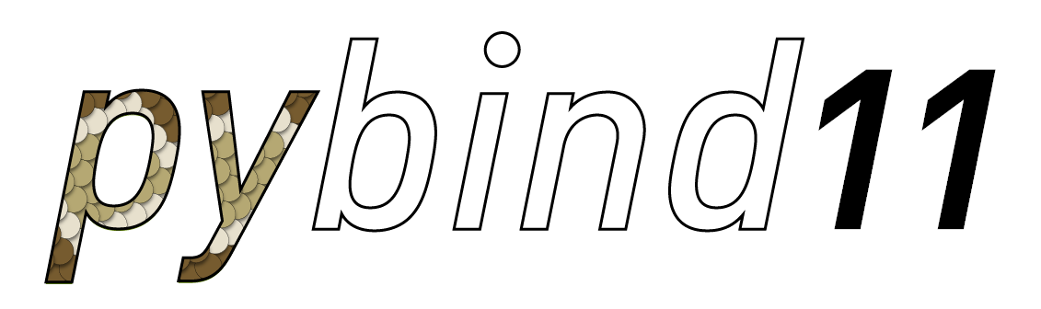
torch.memory_format
Mainly relevant for developing C++ extensions
pybind11 — Seamless operability between C++11 and Python

Slide 43
torch.memory_format
torch.contiguous_format | Tensor is or will be allocated in dense non-overlapping memory. Strides represented by values in decreasing order.
torch.channels_last
torch.channels_last_3d
torch.preserve_format
For a tensor X with shape [batch_size, channels, height, width]
and a specific element at position [b, c, h, w], the memory offset
(in number of elements) from the start of the tensor would be:
offset = b * (channels * height * width) + c * (height * width) + h * width + w

Slide 44
torch.Tensor.data_ptr
“Returns the address of the first element of self tensor.”
torch.Tensor.contiguous
Tensor.contiguous(memory_format=torch.contiguous_format) → Tensor
“Returns a contiguous in memory tensor containing the same data as self tensor. If self tensor is already in the specified memory format, this function returns the self tensor.”
torch.Tensor.is_contiguous
Tensor.is_contiguous(memory_format=torch.contiguous_format) → bool
“Returns True if self tensor is contiguous in memory in the order specified by memory format.“

Slide 45

Data augmentation
Photo by Udo Ernst

Slide 46
Data augmentation
The goal is to automatically produce variants of an input pattern.
Thus increasing the amount of training data several fold.

Slide 47
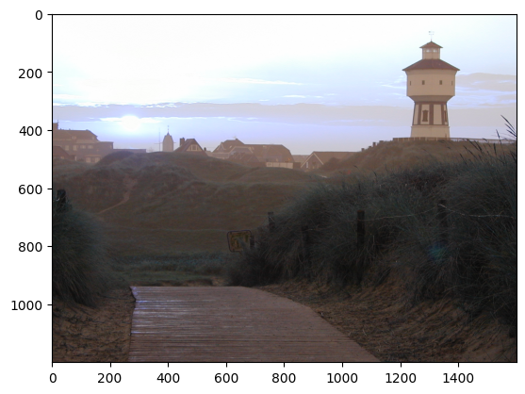
Loading an example image
(with opencv2)
Load it via cv2.imread( filename[, flags]) -> retval
import cv2
import matplotlib.pyplot as plt
filename: str = "data_augmentation_test_image.jpg"
original_image = cv2.imread(filename)
plt.imshow(original_image)
plt.show()
As you can see (not very well, I might add) is that the color channels are wrong.

Slide 48
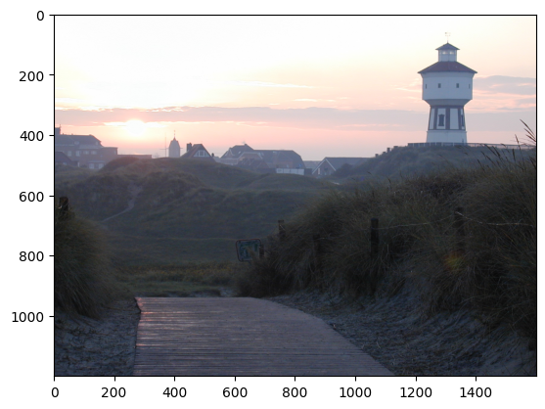
Loading an example image
import numpy as np
original_image = cv2.imread(filename, cv2.IMREAD_COLOR)
# "Convert" from BlueGreenRed (BGR) to RGB (RedGreenBlue)
# This is a flip in the third dimension.
original_image = np.flip(original_image, axis=2)
plt.imshow(original_image)
plt.show()

Slide 49
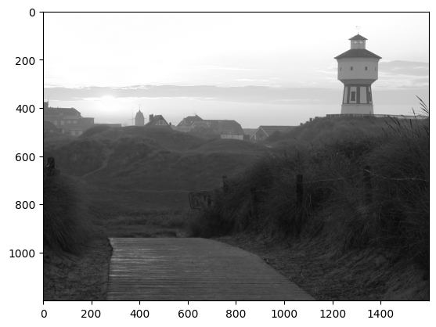
Loading an example image in grayscale
original_image = cv2.imread(filename, cv2.IMREAD_GRAYSCALE)
plt.imshow(original_image, cmap="gray")
plt.show()
But may be we want no color anyway
Other options can be found here

Slide 50
torchvision
“The torchvision package consists of popular datasets, model architectures, and common image transformations for computer vision.”
V1 or V2? Which one should I use?
“TL;DR We recommending using the torchvision.transforms.v2 transforms instead of those in torchvision.transforms. They’re faster and they can do more things. Just change the import and you should be good to go. Moving forward, new features and improvements will only be considered for the v2 transforms.”

Slide 51
Test setup
import torch
import cv2
import matplotlib.pyplot as plt
from torchvision.transforms import v2 # type: ignore
filename: str = "data_augmentation_test_image.jpg"
original_image = cv2.imread(filename, cv2.IMREAD_COLOR)
torch_image = (
(torch.tensor(original_image).flip(dims=(2,)).type(dtype=torch.float32) / 255.0)
.movedim(-1, 0)
.unsqueeze(0))
print(torch_image.shape) # torch.Size([1, 3, 1200, 1600])
transforms = v2.Compose([ SOME TRANSFORMATION])
plt.imshow(transforms(torch_image)[0, ...].movedim(0, -1).detach().numpy())
plt.show()

Slide 52
Compose
torchvision.transforms.v2.Compose(transforms: Sequence[Callable])
We use compose to chain transformations together like:
v2.Compose([
v2.CenterCrop(10),
v2.PILToTensor(),
v2.ConvertImageDtype(torch.float),])
As an alternative you may want to use torch.nn.Sequential

Slide 53
RandomApply
torchvision.transforms.v2.RandomApply(transforms: Union[Sequence[Callable], ModuleList], p: float = 0.5)
“Apply randomly a list of transformations with a given probability.”
v2.RandomApply([
v2.CenterCrop(10),
v2.PILToTensor(),
v2.ConvertImageDtype(torch.float),])
Note: It randomly applies the whole list of transformation or none.

Slide 54
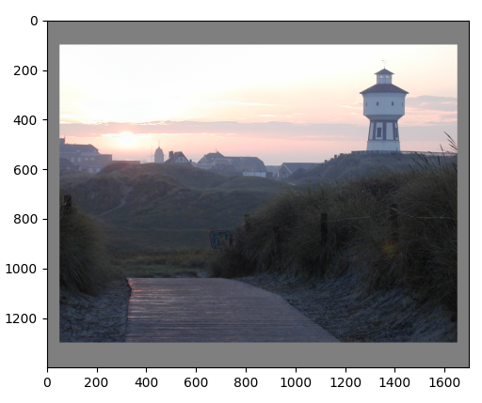
Example from V2: Pad
torchvision.transforms.v2.Pad(padding: Union[int, Sequence[int]], fill: Union[int, float, Sequence[int], Sequence[float], None, Dict[Union[Type, str], Optional[Union[int, float, Sequence[int], Sequence[float]]]]] = 0, padding_mode: Literal['constant', 'edge', 'reflect', 'symmetric'] = 'constant')
transforms = v2.Compose([v2.Pad(padding=(50, 100), fill=0.5)])

Slide 55
Example from V2: Flip
Horizontal Vertical
Horizontally flip the input with a given probability.
torchvision.transforms.v2.RandomHorizontalFlip(p: float = 0.5)
Vertically flip the input with a given probability.
torchvision.transforms.v2.RandomVerticalFlip(p: float = 0.5)

Slide 56
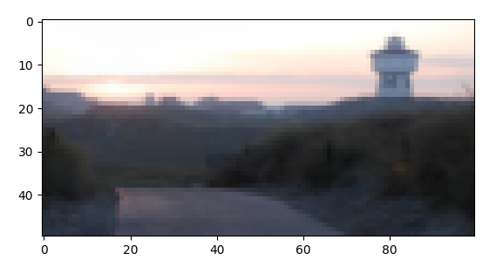
Example from V2: Resize
torchvision.transforms.v2.Resize(size: Optional[Union[int, Sequence[int]]], interpolation: Union[InterpolationMode, int] = InterpolationMode.BILINEAR, max_size: Optional[int] = None, antialias: Optional[bool] = True)
Resize the input to the given size.
transforms = v2.Compose([v2.Resize(size=(50, 100))])

Slide 57
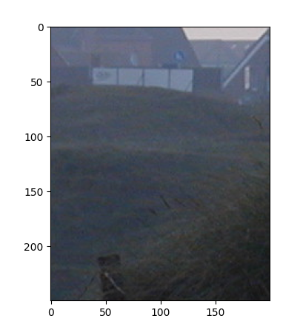
Example from V2: CenterCrop
torchvision.transforms.v2.CenterCrop(size: Union[int, Sequence[int]])
Crop the input at the center.
transforms = v2.Compose([v2.CenterCrop(size=(250, 200))])

Slide 58
Example from V2: FiveCrop
torchvision.transforms.v2.FiveCrop(size: Union[int, Sequence[int]])
Crop the image or video into four corners and the central crop.
print(torch_image.shape) # torch.Size([1, 3, 1200, 1600])
transforms = v2.Compose([v2.FiveCrop(size=(250, 200))])
output = transforms(torch_image)
print(len(output)) # 5
print(output[0].shape) # torch.Size([1, 3, 250, 200])

Slide 59
Example from V2: TenCrop
torchvision.transforms.v2.TenCrop(size: Union[int, Sequence[int]], vertical_flip: bool = False)
Crop the image or video into four corners and the central crop plus the flipped version of these (horizontal flipping is used by default).
transforms = v2.Compose([v2.TenCrop(size=(250, 200))])
output = transforms(torch_image)
print(len(output)) # 10
print(output[0].shape) # torch.Size([1, 3, 250, 200])

Slide 60
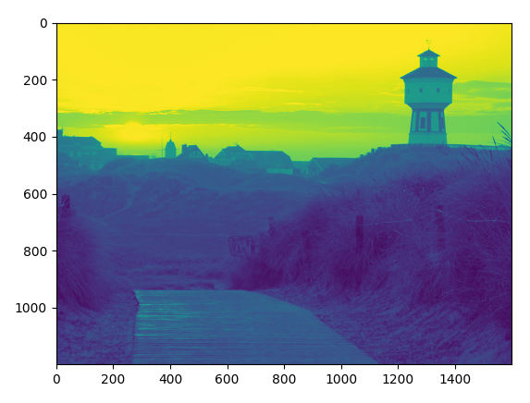
Example from V2: Grayscale
torchvision.transforms.v2.Grayscale(num_output_channels: int = 1)
Crop the image or video into four corners and the central crop plus the flipped version of these (horizontal flipping is used by default).
transforms = v2.Compose([v2.Grayscale()])
print(transforms(torch_image).shape) # torch.Size([1, 1, 1200, 1600])

Slide 61
Example from V2
RandomGrayscale
torchvision.transforms.v2.RandomGrayscale(p: float = 0.1)
Randomly convert image or videos to grayscale with a probability of p (default 0.1).
RandomInvert
torchvision.transforms.v2.RandomInvert(p: float = 0.5)
Inverts the colors of the given image or video with a given probability.
RandomEqualize
torchvision.transforms.v2.RandomEqualize(p: float = 0.5)
Equalize the histogram of the given image or video with a given probability.

Slide 62
Example from V2
Normalize
torchvision.transforms.v2.Normalize(mean: Sequence[float], std: Sequence[float], inplace: bool = False)
Normalize a tensor image or video with mean and standard deviation.
ColorJitter
torchvision.transforms.v2.ColorJitter(
brightness: Optional[Union[float, Sequence[float]]] = None,
contrast: Optional[Union[float, Sequence[float]]] = None,
saturation: Optional[Union[float, Sequence[float]]] = None,
hue: Optional[Union[float, Sequence[float]]] = None)
Randomly change the brightness, contrast, saturation and hue of an image or video.

Slide 63
Example from V2
GaussianBlur
torchvision.transforms.v2.GaussianBlur(kernel_size: Union[int, Sequence[int]], sigma: Union[int, float, Sequence[float]] = (0.1, 2.0))
Blurs image with randomly chosen Gaussian blur kernel.
GaussianNoise
torchvision.transforms.v2.GaussianNoise(mean: float = 0.0, sigma: float = 0.1, clip=True)
Add gaussian noise to images or videos.

Slide 64
Example from V2
RandomPerspective
torchvision.transforms.v2.RandomPerspective(distortion_scale: float = 0.5, p: float = 0.5, interpolation: Union[InterpolationMode, int] = InterpolationMode.BILINEAR, fill: Union[int, float, Sequence[int], Sequence[float], None, Dict[Union[Type, str], Optional[Union[int, float, Sequence[int], Sequence[float]]]]] = 0)
Perform a random perspective transformation of the input with a given probability.
RandomRotation
torchvision.transforms.v2.RandomRotation(degrees: Union[Number, Sequence], interpolation: Union[InterpolationMode, int] = InterpolationMode.NEAREST, expand: bool = False, center: Optional[List[float]] = None, fill: Union[int, float, Sequence[int], Sequence[float], None, Dict[Union[Type, str], Optional[Union[int, float, Sequence[int], Sequence[float]]]]] = 0)
Rotate the input by angle.

Slide 65
Example from V2
RandomAffine
torchvision.transforms.v2.RandomAffine(degrees: Union[Number, Sequence], translate: Optional[Sequence[float]] = None, scale: Optional[Sequence[float]] = None, shear: Optional[Union[int, float, Sequence[float]]] = None, interpolation: Union[InterpolationMode, int] = InterpolationMode.NEAREST, fill: Union[int, float, Sequence[int], Sequence[float], None, Dict[Union[Type, str], Optional[Union[int, float, Sequence[int], Sequence[float]]]]] = 0, center: Optional[List[float]] = None)
Random affine transformation the input keeping center invariant.

Slide 66
Example from V2
RandomCrop
torchvision.transforms.v2.RandomCrop(size: Union[int, Sequence[int]], padding: Optional[Union[int, Sequence[int]]] = None, pad_if_needed: bool = False, fill: Union[int, float, Sequence[int], Sequence[float], None, Dict[Union[Type, str], Optional[Union[int, float, Sequence[int], Sequence[float]]]]] = 0, padding_mode: Literal['constant', 'edge', 'reflect', 'symmetric'] = 'constant')
Crop the input at a random location.
AND MANY MORE...

Slide 67
Auto-Augmentation
“AutoAugment is a common Data Augmentation technique that can improve the accuracy of Image Classification models. Though the data augmentation policies are directly linked to their trained dataset, empirical studies show that ImageNet policies provide significant improvements when applied to other datasets. In TorchVision we implemented 3 policies learned on the following datasets: ImageNet, CIFAR10 and SVHN. “

Slide 68
AutoAugment
torchvision.transforms.v2.AutoAugment(policy: AutoAugmentPolicy = AutoAugmentPolicy.IMAGENET, interpolation: Union[InterpolationMode, int] = InterpolationMode.NEAREST, fill: Union[int, float, Sequence[int], Sequence[float], None, Dict[Union[Type, str], Optional[Union[int, float, Sequence[int], Sequence[float]]]]] = None)
AutoAugment data augmentation method based on “AutoAugment: Learning Augmentation Strategies from Data”.
Available policies are IMAGENET, CIFAR10 and SVHN.

Slide 69
RandAugment
torchvision.transforms.v2.RandAugment(num_ops: int = 2, magnitude: int = 9, num_magnitude_bins: int = 31, interpolation: Union[InterpolationMode, int] = InterpolationMode.NEAREST, fill: Union[int, float, Sequence[int], Sequence[float], None, Dict[Union[Type, str], Optional[Union[int, float, Sequence[int], Sequence[float]]]]] = None)
RandAugment data augmentation method based on “RandAugment: Practical automated data augmentation with a reduced search space”.
Available policies are IMAGENET, CIFAR10 and SVHN.

Slide 70
What I use: MNIST
train_processing_chain = v2.Compose(
transforms=[
v2.RandomCrop((input_dim_x, input_dim_y))
],
)
test_processing_chain = v2.Compose(
transforms=[
v2.CenterCrop((input_dim_x, input_dim_y))
],
)
input_dim_x: int = 24
input_dim_y: int = 24

Slide 71
What I use: CIFAR10 (test)
test_processing_chain = v2.Compose(
transforms=[
v2.CenterCrop((input_dim_x, input_dim_y))
],
)
input_dim_x: int = 28
input_dim_y: int = 28
flip_p: float = 0.5
jitter_brightness: float = 0.5
jitter_contrast: float = 0.1
jitter_saturation: float = 0.1
jitter_hue: float = 0.15

Slide 72
What I use: CIFAR10 (training)
train_processing_chain = v2.Compose(
transforms=[
v2.RandomCrop((input_dim_x, input_dim_y)),
v2.RandomHorizontalFlip(p=flip_p),
v2.ColorJitter(
brightness=jitter_brightness,
contrast=jitter_contrast,
saturation=jitter_saturation,
hue=jitter_hue,
),
],
)

Slide 73
What I use: CIFAR10 (automatic)
train_processing_chain = v2.Compose(
transforms=[
v2.AutoAugment(policy=v2.AutoAugmentPolicy(v2.AutoAugmentPolicy.CIFAR10)),
v2.CenterCrop((input_dim_x, input_dim_y)),
],
)

Slide 74
Building your own filter
from torchvision.transforms.v2 import Transform # type: ignore
import torch
from typing import Any
class OnOffFilter(Transform):
def __init__(self, p: float = 0.5) -> None:
super().__init__()
self.p: float = p
def _transform(self, inpt: Any, params: dict[str, Any]) -> Any:
return torch.cat(
(
torch.nn.functional.relu(self.p - inpt),
torch.nn.functional.relu(inpt - self.p),
),
dim=1,
)
def __repr__(self):
return self.__class__.__name__ + "(p={0})".format(self.p)

Slide 75
Building your own filter
print(torch_image.shape) # torch.Size([1, 3, 1200, 1600])
transforms = v2.Compose([OnOffFilter()])
print(transforms(torch_image).shape) # torch.Size([1, 6, 1200, 1600])

Slide 76
Dataloader

Slide 77
Anatomy of a PyTorch Network + Support
Training of the weights
Target
Output
Loss function
Layer N
Optimizer
Learning Rate
Scheduler
Layer 2
Layer 1
Dataloader
Network
(torch.nn.sequential)

Slide 78
Data provider

Slide 79
torchvision.datasets
Here you find a collection of the many benchmark datasets

Slide 80
Torchvision data provider: MNIST
import torchvision # type: ignore
tv_dataset_train = torchvision.datasets.MNIST(root="data", train=True, download=True)
tv_dataset_test = torchvision.datasets.MNIST(root="data", train=False,
download=True)
print(len(tv_dataset_train)) # 60000
print(len(tv_dataset_test)) # 10000
print(tv_dataset_test[0][0]) # <PIL.Image.Image image mode=L size=28x28 at 0x7F876166D5E0>
print(tv_dataset_test[0][1]) # 7

Slide 81
Torchvision data provider: FashionMNIST
import torchvision # type: ignore
tv_dataset_train = torchvision.datasets.FashionMNIST(
root="data", train=True, download=True)
tv_dataset_test = torchvision.datasets.FashionMNIST(
root="data", train=False, download=True)
print(len(tv_dataset_train)) # 60000
print(len(tv_dataset_test)) # 10000
print(
tv_dataset_test[0][0]
) # <PIL.Image.Image image mode=L size=28x28 at 0x7FC794E96C30>
print(tv_dataset_test[0][1]) # 9

Slide 82
Torchvision data provider: CIFAR10
import torchvision # type: ignore
tv_dataset_train = torchvision.datasets.CIFAR10(
root="data", train=True, download=True)
tv_dataset_test = torchvision.datasets.CIFAT10(
root="data", train=False, download=True)
print(len(tv_dataset_train)) # 50000
print(len(tv_dataset_test)) # 10000
print(
tv_dataset_test[0][0]
) # <PIL.Image.Image image mode=RGB size=32x32 at 0x7F2F03BE0F80>
print(tv_dataset_test[0][1]) # 3

Slide 83
Dealing with you own data

Slide 84
Dataset
There are different types of datasets available that are derived from Dataset
torch.utils.data.IterableDataset | An iterable Dataset.
torch.utils.data.TensorDataset | Dataset wrapping tensors.
torch.utils.data.StackDataset | Dataset as a stacking of multiple datasets.
torch.utils.data.ConcatDataset | Dataset as a concatenation of multiple datasets.
torch.utils.data.ChainDataset | Dataset for chaining multiple IterableDataset s.

Slide 85
torch.utils.data.TensorDataset(*tensors)
label_tensor = torch.randint(0, 9, (10,))
image_tensor = torch.rand((10, 1, 28, 28))
dataset = torch.utils.data.TensorDataset(image_tensor, label_tensor)
The order of image tensor and label vector you put in here, you will get out later.

Slide 86
torch.utils.data.Dataset
In the case we might not be able to load the fully dataset into memory, the torch.utils.data.Dataset is very helpful.
“All datasets that represent a map from keys to data samples should subclass it. All subclasses should overwrite __getitem__(), supporting fetching a data sample for a given key. “
“Subclasses could also optionally overwrite __len__(), which is expected to return the size of the dataset by many Sampler implementations and the default options of DataLoader.”
Subclasses could also optionally implement __getitems__(), for speedup batched samples loading. This method accepts list of indices of samples of batch and returns list of samples.

Slide 87
Example (__init__)
import numpy as np import torch
class MyDataset(torch.utils.data.Dataset):
# Initialize
def __init__(self, train: bool = False) -> None:
super().__init__()
if train is True:
self.pattern_storage: np.ndarray = np.load("train_pattern_storage.npy")
self.label_storage: np.ndarray = np.load("train_label_storage.npy")
else:
self.pattern_storage = np.load("test_pattern_storage.npy")
self.label_storage = np.load("test_label_storage.npy")
self.pattern_storage = self.pattern_storage.astype(np.float32)
self.pattern_storage /= np.max(self.pattern_storage)
# How many pattern are there?
self.number_of_pattern: int = self.label_storage.shape[0]

Slide 88
Example (__len__ & __getitem__)
def __len__(self) -> int:
return self.number_of_pattern # Get one pattern at position index
def __getitem__(self, index: int) -> tuple[torch.Tensor, int]:
image = torch.tensor(self.pattern_storage[index, ...])
target = int(self.label_storage[index])
return image, target

Slide 89
torch.utils.data.DataLoader
torch.utils.data.DataLoader(dataset, batch_size=1, shuffle=None, sampler=None, batch_sampler=None, num_workers=0, collate_fn=None, pin_memory=False, drop_last=False, timeout=0, worker_init_fn=None, multiprocessing_context=None, generator=None, *, prefetch_factor=None, persistent_workers=False, pin_memory_device='', in_order=True)
Important parameter
dataset (Dataset) | dataset from which to load the data.
batch_size (int, optional) | how many samples per batch to load (default: 1).
shuffle (bool, optional) | set to True to have the data reshuffled at every epoch (default: False).

Slide 90
Autograd
“torch.autograd is PyTorch’s automatic differentiation engine that powers neural network training”

Slide 91
Automatic Differentiation with torch.autograd
Output
Output
Loss
Function
Loss
Target
+
Parameter
b
import torch
input = torch.ones(5) target = torch.zeros(3)
w = torch.randn(5, 3, requires_grad=True)
b = torch.randn(3, requires_grad=True)
output = input @ w + b
loss = ((output - target) ** 2).sum()
@
Parameter
w
Input
@ = Matrix Multiplication

Slide 92
“Parameters“
W and b are in this example parameters to be optimized.
Hence the requires_grad=True during their creation:
w = torch.randn(5, 3, requires_grad=True)
b = torch.randn(3, requires_grad=True)
If not used during creation, it can be changed later via
torch.Tensor.requires_grad_
Tensor.requires_grad_(requires_grad=True) → Tensor
“Change if autograd should record operations on this tensor: sets this tensor’s requires_grad attribute in-place. Returns this tensor.”

Slide 93
Backprop — torch.Tensor.backward
Tensor.backward(gradient=None, retain_graph=None, create_graph=False, inputs=None)
“Computes the gradient of current tensor wrt graph leaves.”
In our example:
print(w.grad) # None
print(b.grad) # None
loss.backward()
print(w.grad) # tensor([[1.6797, 2.3785, 7.0936], ...
print(b.grad) # tensor([1.6797, 2.3785, 7.0936])

Slide 94
Backprop
The other tensors don’t get a gradient
loss.backward()
print(input.grad) # None
print(output.grad) # None + Complains from PyTorch for even asking
print(target.grad) # None
print(loss.grad) # None + Complains from PyTorch for even asking
And don’t call backward more then once:
loss.backward()
loss.backward()
# RuntimeError: Trying to backward through the graph a second time (or directly access saved tensors after they have already been freed). ...

Slide 95
Computational graph
If something is involved with requires_grad=True, a computational graph is created:
output = input @ w + b
loss = ((output - target) ** 2).sum()
print(output.grad_fn) # <AddBackward0 object at 0x7ff23f05d7e0>
print(loss.grad_fn) # <SumBackward0 object at 0x7ff23f05d7e0>
However this uses extra memory usage and computation cost. Sometimes we want prevent this behaviour.
no_grad
torch.no_grad(orig_func=None)
“Context-manager that disables gradient calculation.”
with torch.no_grad():
output = input @ w + b
loss = ((output - target) ** 2).sum()
print(output.grad_fn) # None
print(loss.grad_fn) # None

Slide 96
Walking the graph — For debugging
position = loss.grad_fn
while position is not None:
print(position.next_functions)
position = position.next_functions[0][0]
((<PowBackward0 object at 0x7f1b7fdc57e0>, 0),)
((<SubBackward0 object at 0x7f1b7fe26440>, 0),)
((<AddBackward0 object at 0x7f1b7fdc57e0>, 0), (None, 0))
((<SqueezeBackward4 object at 0x7f1b7fe26440>, 0),
(<AccumulateGrad object at 0x7f1c64bed7e0>, 0))
((<MmBackward0 object at 0x7f1b7fdc57e0>, 0),)
((None, 0), (<AccumulateGrad object at 0x7f1b7fe26440>, 0))

Slide 97
Inplace operations are now a no-no
output = b
output += input @ w
# RuntimeError: a leaf Variable that requires grad is being used in an in-place operation.

Slide 98
Parameter

Slide 99
The intended way — Parameter
In reality we don’t do this:
w = torch.randn(5, 3, requires_grad=True)
b = torch.randn(3, requires_grad=True)
we do this:
Parameter
torch.nn.parameter.Parameter(data=None, requires_grad=True)
“A kind of Tensor that is to be considered a module parameter.”
w = torch.nn.Parameter(torch.randn(5, 3))
b = torch.nn.Parameter(torch.randn(3))

Slide 100
A new pitfall
However, this is not allowed any more:
X
w = torch.nn.Parameter(torch.randn(5, 3))
w = w * 2
You need to access the data via .data
w = torch.nn.Parameter(torch.randn(5, 3))
w.data = w.data * 2
w.data = torch.randn(5, 3)
!
You need to remember this if you want to change a parameter e.g. for initializing it.

