Slide 1

PyTorch Introduction
Training a network
David Rotermund & Udo Ernst

Slide 2
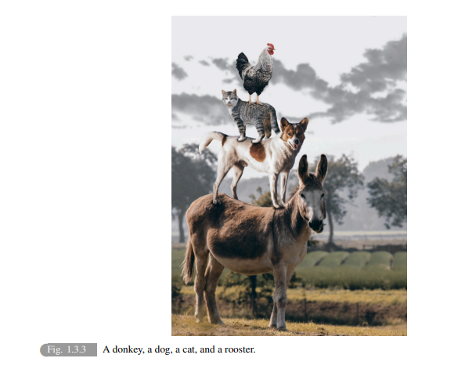
Open Book: Dive into Deep Learning
Recommendation
ASTON ZHANG
ZACHARY C. LIPTON
MU LI
ALEXANDER J. SMOLA
https://d2l.ai/d2l-en.pdf

Slide 3
Anatomy of a PyTorch Network + Support
Training of the weights
Target
Output
Loss function
Layer N
Optimizer
Learning Rate
Scheduler
Layer 2
Layer 1
Dataloader
Network
(torch.nn.sequential)

Slide 4
Anatomy of a PyTorch Network + Support
Inference
Output
Layer N
Layer 2
Layer 1
Dataloader
Network
(torch.nn.sequential)

Slide 5
Optimizer & Learning Rate Scheduler

Slide 6
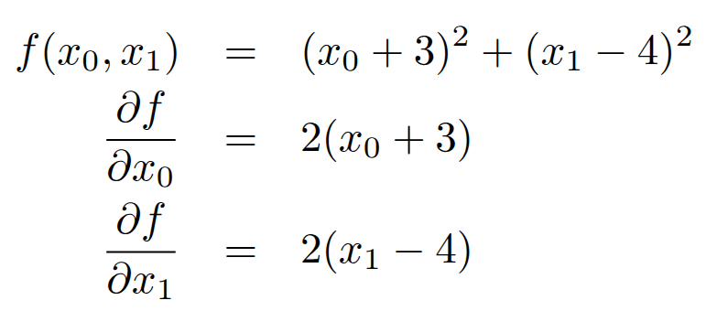
Optimize an equation by hand

Slide 7
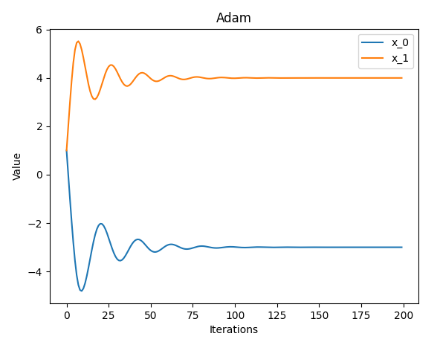
Optimize an equation by hand

Slide 8
import torch
parameter: torch.nn.Parameter = torch.nn.Parameter(
torch.ones((2,), dtype=torch.float32)
)
optimizer = torch.optim.Adam([parameter], lr=1)
max_range: int = 200
values: torch.Tensor = torch.zeros(
(max_range, 2), dtype=parameter.data.dtype, device=parameter.data.device
)
for i in range(0, max_range):
optimizer.zero_grad()
parameter.grad = torch.tensor(
[2 * (parameter.data[0] + 3), 2 * (parameter.data[1] - 4)],
dtype=parameter.data.dtype,
device=parameter.data.device,
)
values[i, 0] = parameter.data[0]
values[i, 1] = parameter.data[1]
optimizer.step()
Remember: A parameter has
.data and .grad !
Optimizer
Optimizer
Optimizer

Slide 9
Plot the results
import matplotlib.pyplot as plt
plt.plot(values[:, 0].detach().cpu().numpy(), label="x_0")
plt.plot(values[:, 1].detach().cpu().numpy(), label="x_1")
plt.title("Adam")
plt.legend()
plt.xlabel("Iterations")
plt.ylabel("Value")
plt.show()

Slide 10
Optimizers
There are (too) many different optimizers available.
However, typically Adam and SGD can deal with most of the usual cases.
SGD
torch.optim.SGD(params, lr=0.001, momentum=0, dampening=0, weight_decay=0, nesterov=False, *, maximize=False, foreach=None, differentiable=False, fused=None)
Implements stochastic gradient descent (optionally with momentum).
Adam
torch.optim.Adam(params, lr=0.001, betas=(0.9, 0.999), eps=1e-08, weight_decay=0, amsgrad=False, *, foreach=None, maximize=False, capturable=False, differentiable=False, fused=None)
Implements Adam algorithm.
Adam: A Method for Stochastic Optimization

Slide 11
Save and restore the optimizer state
# Save the state
optimizer_state = optimizer.state_dict()
print(optimizer.state_dict()["state"][0]["step"]) # tensor(200.)
# Destroy the state
optimizer = torch.optim.Adam([parameter], lr=1)
print(optimizer.state_dict()["state"]) # {}
# Restore the state
optimizer.load_state_dict(optimizer_state)
print(optimizer.state_dict()["state"][0]["step"]) # tensor(200.)

Slide 12
step(closure=None)
Perform a single optimization step.
zero_grad(set_to_none=True)
Reset the gradients of all optimized torch.Tensors.
Per-parameter options
“Optimizers also support specifying per-parameter options.”
(i.e. different learning rate values for different sets of parameter)
With one set of parameters, we can readout the learning rate via:
optimizer.param_groups[-1]["lr"]

Slide 13
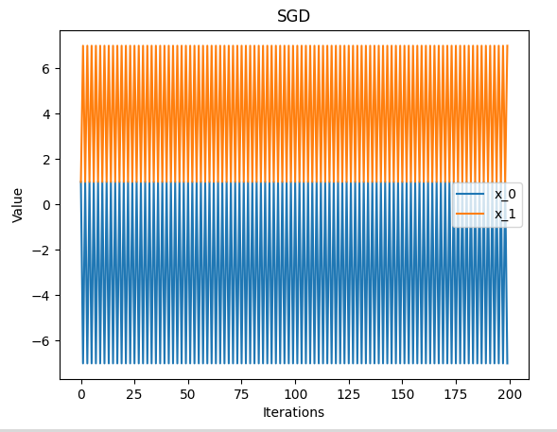
Optimizer fails due to a too large learning rate?

Slide 14
Learning Rate Scheduler
Connecting a learning rate scheduler to the optimizer
optimizer = torch.optim.SGD([parameter], lr=1)
lr_scheduler = torch.optim.lr_scheduler.ReduceLROnPlateau(optimizer)
Feeding the quality (here the value of f(x_0,x_1)) of the calculation into the lr scheduler
optimizer.step()
lr_scheduler.step((parameter.data[0] + 3) ** 2 + (parameter.data[1] - 4) ** 2)

Slide 15
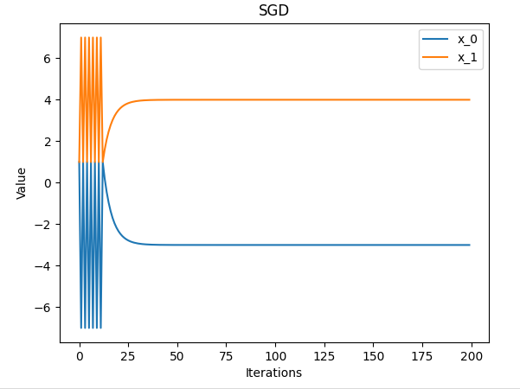
SGD works now

Slide 16
Two types of LR scheduler
With feedback
ReduceLROnPlateau
torch.optim.lr_scheduler.ReduceLROnPlateau(optimizer, mode='min', factor=0.1, patience=10, threshold=0.0001, threshold_mode='rel', cooldown=0, min_lr=0, eps=1e-08, verbose='deprecated')
step(metrics, epoch=None)
“Perform a step.”
Without feedback
CosineAnnealingLR
torch.optim.lr_scheduler.CosineAnnealingLR(optimizer, T_max, eta_min=0.0, last_epoch=-1, verbose='deprecated')
step(epoch=None)
“Perform a step.”

Slide 17
Getting the learning rate
get_last_lr()
“Return last computed learning rate by current scheduler.”
get_lr()
“Compute learning rate using chainable form of the scheduler.”
I got a “NotImplementedError” for this one.
Or read it out from the optimizer:
optimizer.param_groups[-1]["lr"]

Slide 18
Types of LR Scheduler
There are many different LR Schedulers
Find a list here.

Slide 19
Anatomy of a PyTorch Network + Support
Training of the weights
Target
Output
Loss function
Layer N
Optimizer
Learning Rate
Scheduler
Layer 2
Layer 1
Dataloader
Network
(torch.nn.sequential)

Slide 20
Tensorboard
Tensorboard is for logging the progress of training your network.
While Tensorboard is fully open source,
there also exists the freemium service Weights & Biases.

Slide 21
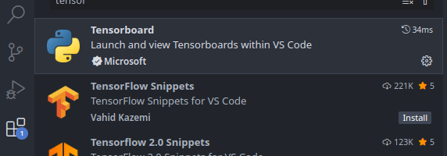
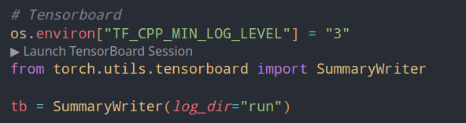
Tensorboard
pip install tensorboard
For VS Code install the Tensorflow extension
Can be used in the editor like this:

Slide 22
torch.utils.tensorboard
torch.utils.tensorboard.writer.SummaryWriter(log_dir=None, comment='', purge_step=None, max_queue=10, flush_secs=120, filename_suffix='')
“Writes entries directly to event files in the log_dir to be consumed by TensorBoard.”
add_scalar(tag, scalar_value, global_step=None, walltime=None, new_style=False, double_precision=False)
“Add scalar data to summary.”
add_histogram(tag, values, global_step=None, bins='tensorflow', walltime=None, max_bins=None)
“Add histogram to summary.”
Also available:
add_scalars, add_image, add_images, add_figure, add_video, add_audio, add_text, add_graph, add_embedding, add_custom_scalars, add_mesh, add_hparams

Slide 23
torch.utils.tensorboard
flush()
“Flushes the event file to disk.
Call this method to make sure that all pending events have been written to disk.”
close()
Closes the SummaryWriter instanz

Slide 24
Simplified example
# Tensorboard
os.environ["TF_CPP_MIN_LOG_LEVEL"] = "3"
from torch.utils.tensorboard import SummaryWriter
tb = SummaryWriter(log_dir="run")
[...]
for epoch_id in range(0, number_of_epoch):
[...]
tb.add_scalar("Error Test", 100.0 - perfomance_test_correct, epoch_id)
tb.flush()
[...]
tb.close()

Slide 25
import os
import glob
os.environ["TF_CPP_MIN_LOG_LEVEL"] = "3"
from tensorboard.backend.event_processing
import event_accumulator # type: ignore
import numpy as np def get_data(path: str):
acc = event_accumulator.EventAccumulator(path)
acc.Reload()
which_scalar = "Error Test"
te = acc.Scalars(which_scalar)
np_temp = np.zeros((len(te), 2))
for id in range(0, len(te)):
np_temp[id, 0] = te[id].step
np_temp[id, 1] = te[id].value
np_temp = np.nan_to_num(np_temp)
print(np_temp)
return np_temp
for path in glob.glob("run*"):
print(path)
data = get_data(path)
np.save("data_" + path + ".npy", data)
How to read out data from Tensorboard files

Slide 26
Loss functions
This is how we measure what we have against what we want.

Slide 27
There are too many loss functions
torch.nn.L1Loss | Creates a criterion that measures the mean absolute error (MAE) between each element in the input
torch.nn.MSELoss | Creates a criterion that measures the mean squared error (squared L2 norm) between each element in the input
torch.nn.CrossEntropyLoss | This criterion computes the cross entropy loss between input logits and target.
torch.nn.CTCLoss | The Connectionist Temporal Classification loss.
torch.nn.NLLLoss | The negative log likelihood loss.
torch.nn.PoissonNLLLoss | Negative log likelihood loss with Poisson distribution of target.
torch.nn.GaussianNLLLoss | Gaussian negative log likelihood loss.
torch.nn.KLDivLoss | The Kullback-Leibler divergence loss.
torch.nn.BCELoss | Creates a criterion that measures the Binary Cross Entropy between the target and the input probabilities:
torch.nn.BCEWithLogitsLoss | This loss combines a Sigmoid layer and the BCELoss in one single class.
torch.nn.MarginRankingLoss | Creates a criterion that measures the loss
torch.nn.HingeEmbeddingLoss | Measures the loss given an input tensor
torch.nn.MultiLabelMarginLoss | Creates a criterion that optimizes a multi-class multi-classification hinge loss (margin-based loss)
torch.nn.HuberLoss | Creates a criterion that uses a squared term if the absolute element-wise error falls below delta and a delta-scaled L1 term otherwise.
torch.nn.SmoothL1Loss | Creates a criterion that uses a squared term if the absolute element-wise error falls below beta and an L1 term otherwise.
torch.nn.SoftMarginLoss | Creates a criterion that optimizes a two-class classification logistic loss
torch.nn.MultiLabelSoftMarginLoss | Creates a criterion that optimizes a multi-label one-versus-all loss based on max-entropy
torch.nn.CosineEmbeddingLoss | Creates a criterion that measures the loss given input tensors and a Tensor label
torch.nn.MultiMarginLoss | Creates a criterion that optimizes a multi-class classification hinge loss (margin-based loss)
torch.nn.TripletMarginLoss | Creates a criterion that measures the triplet loss given an input tensors
torch.nn.TripletMarginWithDistanceLoss | Creates a criterion that measures the triplet loss given input tensors

Slide 28
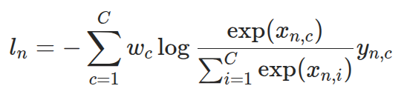
CrossEntropyLoss
torch.nn.CrossEntropyLoss(weight=None, size_average=None, ignore_index=-100, reduce=None, reduction='mean', label_smoothing=0.0)
“This criterion computes the cross entropy loss between input logits and target.”
# Example of target with class indices
loss = nn.CrossEntropyLoss()
input = torch.randn(3, 5, requires_grad=True)
target = torch.empty(3, dtype=torch.long).random_(5)
output = loss(input, target)
output.backward()
# Example of target with class probabilities
loss = nn.CrossEntropyLoss()
input = torch.randn(3, 5, requires_grad=True)
target = torch.randn(3, 5).softmax(dim=1)
output = loss(input, target)
output.backward()

Slide 29
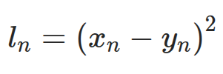
MSELoss
torch.nn.CrossEntropyLoss(weight=None, size_average=None, ignore_index=-100, reduce=None, reduction='mean', label_smoothing=0.0)
Creates a criterion that measures the mean squared error (squared L2 norm) between each element in the input x and target y.
loss = nn.MSELoss()
input = torch.randn(3, 5, requires_grad=True)
target = torch.randn(3, 5)
output = loss(input, target)
output.backward()

Slide 30
Convert labels in one hot encoding (scatter)
number_of_output_neurons = 10
# Convert label into one hot
target_one_hot: torch.Tensor = torch.zeros(
(
target.shape[0],
number_of_output_neurons,
),
device=target.device,
dtype=target.dtype,
)
target_one_hot.scatter_(
1,
target.unsqueeze(1),
torch.ones(
(target.shape[0], 1),
device=target.device,
dtype=target.dtype,
),
)

Slide 31
Anatomy of a PyTorch Network + Support
Training of the weights
Target
Output
Loss function
Layer N
Optimizer
Learning Rate
Scheduler
Layer 2
Layer 1
Dataloader
Network
(torch.nn.sequential)

Slide 32
What makes a layer tick...

Slide 33
Internals of Linear Layer
import torch
import math
class Linear(torch.nn.Module):
__constants__ = ["in_features", "out_features"]
in_features: int
out_features: int
weight: torch.Tensor
Is a child of Module
Information for
just-in-time compilation?
This is probably wrong and should be torch.nn.Parameter

Slide 34
def __init__(
self,
in_features: int,
out_features: int,
bias: bool = True,
device=None,
dtype=None,
) -> None:
factory_kwargs = {"device": device, "dtype": dtype}
super().__init__()
self.in_features = in_features
self.out_features = out_features
self.weight = torch.nn.Parameter(
torch.empty((out_features, in_features), **factory_kwargs)
)
if bias:
self.bias = torch.nn.Parameter(torch.empty(out_features, **factory_kwargs))
else:
self.register_parameter("bias", None)
self.reset_parameters()
Weight
Bias
Parameter initialization

Slide 35
def reset_parameters(self) -> None:
torch.nn.init.kaiming_uniform_(self.weight, a=math.sqrt(5))
if self.bias is not None:
fan_in, _ = torch.nn.init._calculate_fan_in_and_fan_out(self.weight)
bound = 1 / math.sqrt(fan_in) if fan_in > 0 else 0
torch.nn.init.uniform_(self.bias, -bound, bound)
def forward(self, input: torch.Tensor) -> torch.Tensor:
return torch.nn.functional.linear(input, self.weight, self.bias)
def extra_repr(self) -> str:
return (
f"in_features={self.in_features}, "
"out_features={self.out_features}, "
"bias={self.bias is not None}" )
Parameter initialization
Data processing!!!
Pretty printing

Slide 36

The information processing in the layer
def forward(self, input: torch.Tensor) -> torch.Tensor:
return torch.nn.functional.linear(input, self.weight, self.bias)
torch.nn.functional.linear
torch.nn.functional.linear(input, weight, bias=None) → Tensor
“Applies a linear transformation to the incoming data:”
We never see what backwards is doing and it is defined by torch.nn.functional.linear.

Slide 37
Extending torch.autograd

Slide 38
Example — Linear Layer
class FunctionalLinear(torch.autograd.Function):
@staticmethod
def forward( # type: ignore
ctx, input: torch.Tensor, weight: torch.Tensor, bias: torch.Tensor
) -> torch.Tensor:
output = (weight.unsqueeze(0) * input.unsqueeze(1)).sum(dim=-1)
if bias is not None:
output = output + bias.unsqueeze(0)
# #######################################
# Save the necessary data for the backward pass #
########################################
ctx.save_for_backward(
input,
weight,
bias,
)
return output
Normal forward calculation
Storing the data for backward

Slide 39
@staticmethod
@torch.autograd.function.once_differentiable
def backward( # type: ignore
ctx, grad_output: torch.Tensor
) -> tuple[torch.Tensor | None, torch.Tensor | None, torch.Tensor | None]:
# ##############################################
# Get the variables back
# ##############################################
(
input,
weight,
bias,
) = ctx.saved_tensors
All arguments of forward
(except ctx) require a return value.
Retrieving the stored data for backward

Slide 40
# ##############################################
# Default output
# ##############################################
grad_input: torch.Tensor | None = None
grad_weight: torch.Tensor | None = None
grad_bias: torch.Tensor | None = None
grad_weight = grad_output.unsqueeze(-1) * input.unsqueeze(-2)
if bias is not None:
grad_bias = grad_output.detach().clone()
grad_input = (grad_output.unsqueeze(-1) * weight.unsqueeze(0)).sum(dim=1)
return grad_input, grad_weight, grad_bias
All arguments of forward
(except ctx) require a return value.
Default is None
Hopefully correct gradients for
weight & bias
Hopefully correct new
back-propagating error
All arguments of forward
(except ctx) require a return value.

Slide 41
How to include it into your layer
class MyOwnLayer(torch.nn.Module):
def __init__([...]):
[...]
self.reset_parameters()
self.functional_linear = FunctionalLinear.apply
def forward(
self,
input: torch.Tensor,
) -> torch.Tensor:
return self.functional_linear(input, self.weight, self.bias)
!
Not everything needs to be in our own autograd function. In fact, try to put as little as possible into your own autograd function and let the rest handle by torch’s autograd. Less is more.

Slide 42
Extending torch.autograd — When to use
Examples are approximations for backwards when spikes are used for forward
or C++ modules.
“In general, implement a custom function if you want to perform computations in your model that are not differentiable or rely on non-PyTorch libraries (e.g., NumPy), but still wish for your operation to chain with other ops and work with the autograd engine.
In some situations, custom functions can also be used to improve performance and memory usage: If you implemented your forward and backward passes using a C++ extension, you can wrap them in Function to interface with the autograd engine. If you’d like to reduce the number of buffers saved for the backward pass, custom functions can be used to combine ops together.”

Slide 43
Extending torch.autograd — How to use
You’ll need to define two methods:
“forward() is the code that performs the operation. It can take as many arguments as you want, with some of them being optional, if you specify the default values. All kinds of Python objects are accepted here. Tensor arguments that track history (i.e., with requires_grad=True) will be converted to ones that don’t track history before the call, and their use will be registered in the graph. Note that this logic won’t traverse lists/dicts/any other data structures and will only consider tensors that are direct arguments to the call. You can return either a single Tensor output, or a tuple of tensors if there are multiple outputs.
backward() (or vjp()) defines the gradient formula. It will be given as many Tensor arguments as there were outputs, with each of them representing gradient w.r.t. that output. It is important NEVER to modify these in-place. It should return as many tensors as there were inputs, with each of them containing the gradient w.r.t. its corresponding input. If your inputs didn’t require gradient (needs_input_grad is a tuple of booleans indicating whether each input needs gradient computation), or were non-Tensor objects, you can return python:None. Also, if you have optional arguments to forward() you can return more gradients than there were inputs, as long as they’re all None.”

Slide 44
Extending torch.autograd — How to use
“It is your responsibility to use the functions in ctx properly in order to ensure that the new Function works properly with the autograd engine. save_for_backward() must be used to save any tensors to be used in the backward pass. Non-tensors should be stored directly on ctx. If tensors that are neither input nor output are saved for backward your Function may not support double backward”

Slide 45
Extending torch.autograd — How to use
I never had to use these:
“mark_dirty() must be used to mark any input that is modified inplace by the forward function.
mark_non_differentiable() must be used to tell the engine if an output is not differentiable. By default all output tensors that are of differentiable type will be set to require gradient. Tensors of non-differentiable type (i.e., integral types) are never marked as requiring gradients.
set_materialize_grads() can be used to tell the autograd engine to optimize gradient computations in the cases where the output does not depend on the input by not materializing grad tensors given to backward function. That is, if set to False, None object in Python or “undefined tensor” (tensor x for which x.defined() is False) in C++ will not be converted to a tensor filled with zeros prior to calling backward, and so your code will need to handle such objects as if they were tensors filled with zeros. The default value of this setting is True.”

Slide 46
Extending torch.autograd — How to use
“If your Function does not support double backward you should explicitly declare this by decorating backward with the once_differentiable(). With this decorator, attempts to perform double backward through your function will produce an error. See our double backward tutorial for more information on double backward.”

Slide 47
TORCH.AUTOGRAD.FUNCTION.FUNCTIONCTX.SAVE_FOR_BACKWARD
FunctionCtx.save_for_backward(*tensors)
“Saves given tensors for a future call to backward().
save_for_backward should be called at most once, only from inside the forward() method, and only with tensors.
All tensors intended to be used in the backward pass should be saved with save_for_backward (as opposed to directly on ctx) to prevent incorrect gradients and memory leaks, and enable the application of saved tensor hooks.
Note that if intermediary tensors, tensors that are neither inputs nor outputs of forward(), are saved for backward, your custom Function may not support double backward. Custom Functions that do not support double backward should decorate their backward() method with @once_differentiable so that performing double backward raises an error. If you’d like to support double backward, you can either recompute intermediaries based on the inputs during backward or return the intermediaries as the outputs of the custom Function. See the double backward tutorial
for more details.
In backward(), saved tensors can be accessed through the saved_tensors attribute. Before returning them to the user, a check is made to ensure they weren’t used in any in-place operation that modified their content.
Arguments can also be None. This is a no-op.”

Slide 48
Save
ctx.save_for_backward(x, y, w, out)
Non-tensor (e.g. int):
ctx.z = z
Access
x, y, w, out = ctx.saved_tensors
Non-tensor (e.g. int):
z = ctx.z

Slide 49
Converting a function into a layer

Slide 50
Lambda
torchvision.transforms.Lambda(lambd)
“Apply a user-defined lambda as a transform. This transform does not support torchscript.”
import torch
import torchvision.transforms as transforms # type: ignore
# Permute Example
permute_layer = transforms.Lambda(lambda x: torch.permute(x, dims=(0, 2, 3, 1)))
input = torch.zeros((10, 11, 12, 13))
output = permute_layer(input)
print(input.shape) # torch.Size([10, 11, 12, 13])
print(output.shape) # torch.Size([10, 12, 13, 11])
print(permute_layer) # Lambda()

Slide 51
Combining layers into a network
Theoretically there is no need to combine layers into a network but it is much nice to use it as a network

Slide 52
Option 1: a custom class based on torch.nn.Module
import torch
class Network(torch.nn.Module):
def __init__(
self,
input_number_of_channel: int,
number_of_output_channels_conv1: int,
kernel_size_conv1: int,
stride_conv1: int,
padding_conv1: int,
kernel_size_pool1: int,
stride_pool1: int,
padding_pool1: int,
) -> None:
super().__init__()
self.layer_1 = torch.nn.Conv2d(
in_channels=input_number_of_channel,
out_channels=number_of_output_channels_conv1,
kernel_size=kernel_size_conv1,
stride=stride_conv1,
padding=padding_conv1,
)
self.layer_2 = torch.nn.ReLU()
self.layer_3 = torch.nn.MaxPool2d(
kernel_size=kernel_size_pool1, stride=stride_pool1, padding=padding_pool1
)
__init__()
Define the layers as attributes
of the class

Slide 53
Option 1: a custom class based on torch.nn.Module
def forward(self, inputs: torch.Tensor) -> torch.Tensor:
output = self.layer_1(inputs)
output = self.layer_2(output)
output = self.layer_3(output)
return output
forward()
Feeding the data through the
layers.

Slide 54
Option 2: torch.nn.Sequential
torch.nn.Sequential(*args: Module)
“A sequential container.”
network = torch.nn.Sequential(
torch.nn.Conv2d(
in_channels=input_number_of_channel,
out_channels=number_of_output_channels_conv1,
kernel_size=kernel_size_conv1,
stride=stride_conv1,
padding=padding_conv1,
),
torch.nn.ReLU(),
torch.nn.MaxPool2d(
kernel_size=kernel_size_pool1,
stride=stride_pool1,
padding=padding_pool1,
),
)
Define the layers

Slide 55
Option 1 vs Option 2?
I prefer option 2 (torch.nn.Sequential) and use it where possible.
In the moment, option 1 is still necessary for skip connection or branching passes.
I developed and suggested a simple working extension for PyTorch called SequentialSplit but I failed due to politics.
Nevertheless, you can mix both options.

Slide 56
More details for torch.nn.Sequential
network = torch.nn.Sequential(
torch.nn.Conv2d(
in_channels=input_number_of_channel,
out_channels=number_of_output_channels_conv1,
kernel_size=kernel_size_conv1,
stride=stride_conv1,
padding=padding_conv1,
),
torch.nn.ReLU(),
torch.nn.MaxPool2d(
kernel_size=kernel_size_pool1,
stride=stride_pool1,
padding=padding_pool1,
),
)
print(network)
Sequential(
(0): Conv2d(1, 32, kernel_size=(5, 5), stride=(1, 1))
(1): ReLU()
(2): MaxPool2d(kernel_size=(2, 2), stride=(2, 2), padding=0, dilation=1, ceil_mode=False)
)

Slide 57
Dynamically creating the network
network = torch.nn.Sequential()
network.append(
torch.nn.Conv2d(
in_channels=input_number_of_channel,
out_channels=number_of_output_channels_conv1,
kernel_size=kernel_size_conv1,
stride=stride_conv1,
padding=padding_conv1,
)
)
network.append(torch.nn.ReLU())
network.append(
torch.nn.MaxPool2d(
kernel_size=kernel_size_pool1,
stride=stride_pool1,
padding=padding_pool1,
)
)
Append...
Append...
Append...

Slide 58
Labelling layers with add_module
network = torch.nn.Sequential()
network.add_module(
"Conv2d Layer One",
torch.nn.Conv2d(
in_channels=input_number_of_channel,
out_channels=number_of_output_channels_conv1,
kernel_size=kernel_size_conv1,
stride=stride_conv1,
padding=padding_conv1,
),
)
network.append(torch.nn.ReLU())
network.append(
torch.nn.MaxPool2d(
kernel_size=kernel_size_pool1,
stride=stride_pool1,
padding=padding_pool1,
)
)
Use add_module() instead of append()
Sequential(
(Conv2d Layer One): Conv2d(1, 32, kernel_size=(5, 5), stride=(1, 1))
(1): ReLU()
(2): MaxPool2d(kernel_size=(2, 2), stride=(2, 2), padding=0, dilation=1, ceil_mode=False)
)

Slide 59
Lazy layers vs. Intelligent approach
?
Linear
(same for the flatten layer!)
torch.nn.Linear(in_features, out_features, bias=True, device=None, dtype=None)
“Applies an affine linear transformation to the incoming data”
LazyLinear
torch.nn.LazyLinear(out_features, bias=True, device=None, dtype=None)
“A torch.nn.Linear module where in_features is inferred.”
However for many research operations, like manipulating weights before the first use of the network, the lazy layer class has limits.

Slide 60
Intelligent approach
fake_input: torch.Tensor = torch.zeros((1, 3, 28, 28))
network = torch.nn.Sequential() network.append(
torch.nn.Conv2d(
in_channels=input_number_of_channel,
out_channels=number_of_output_channels_conv1,
kernel_size=kernel_size_conv1,
stride=stride_conv1,
padding=padding_conv1,
)
)
print("Pre Conv2d: ", fake_input.shape)
fake_input = network[-1](fake_input)
print("Post Conv2d: ", fake_input.shape)
print()
We create a fake input based on the dimensions for the real input with one pattern in the batch dimension
We feed that data through the last
appended layer i.e. network[-1]
Pre Conv2d: torch.Size([1, 3, 28, 28])
Post Conv2d: torch.Size([1, 32, 24, 24])

Slide 61
Intelligent approach
print("Pre Conv2d: ", fake_input.shape)
fake_input = network[-1](fake_input)
print("Post Conv2d: ", fake_input.shape)
print()
Pre ReLu: torch.Size([1, 32, 24, 24])
Post ReLu: torch.Size([1, 32, 24, 24])

Slide 62
Intelligent approach
network.append(
torch.nn.MaxPool2d(
kernel_size=kernel_size_pool1,
stride=stride_pool1,
padding=padding_pool1,
)
)
print("Pre MaxPool2d: ", fake_input.shape)
fake_input = network[-1](fake_input)
print("Post MaxPool2d: ", fake_input.shape)
print()
Pre MaxPool2d: torch.Size([1, 32, 24, 24])
Post MaxPool2d: torch.Size([1, 32, 12, 12])

Slide 63
Inspecting the network
print(network.__dict__)
{'training': True, '_parameters': {}, '_buffers': {}, '_non_persistent_buffers_set': set(), '_backward_pre_hooks': OrderedDict(), '_backward_hooks': OrderedDict(), '_is_full_backward_hook': None, '_forward_hooks': OrderedDict(), '_forward_hooks_with_kwargs': OrderedDict(), '_forward_hooks_always_called': OrderedDict(), '_forward_pre_hooks': OrderedDict(), '_forward_pre_hooks_with_kwargs': OrderedDict(), '_state_dict_hooks': OrderedDict(), '_state_dict_pre_hooks': OrderedDict(), '_load_state_dict_pre_hooks': OrderedDict(), '_load_state_dict_post_hooks': OrderedDict(), '_modules': {
'0': Conv2d(3, 32, kernel_size=(5, 5), stride=(1, 1)),
'1': ReLU(),
'2': MaxPool2d(kernel_size=(2, 2), stride=(2, 2), padding=0, dilation=1, ceil_mode=False)
}
}
Or use this for the architecture part of the network:
print(network.__dict__["_modules"])

Slide 64
Save / Load the whole network
“whole” means with the structure of the network.
torch.save(network, "torch_network.pt")
network = torch.load("torch_network.pt", weights_only=False)
network.eval()

Slide 65
Save / Load the weights of the network
torch.save(network.state_dict(), "torch_network_dict.pt")
Re-create the network
Replace the weights with the stored weights
network.load_state_dict(torch.load("torch_network_dict.pt", weights_only=True))
network.eval()

Slide 66
A closer look into our layers
for layer_id, layer in enumerate(network):
print(f"Layer ID: {layer_id}")
print(layer)
# or:
# print(network[layer_id])
print()
Layer ID: 0
Conv2d(3, 32, kernel_size=(5, 5), stride=(1, 1))
Layer ID: 1
ReLU()
Layer ID: 2
MaxPool2d(kernel_size=(2, 2), stride=(2, 2), padding=0, dilation=1, ceil_mode=False)

Slide 67
Extracting the activities of the network
activity: list[torch.Tensor] = []
activity.append(input)
for layer in network:
activity.append(layer(activity[-1]))
for id, data in enumerate(activity):
print(f"ID: {id} Shape:{data.shape}")
The initial input goes here...
Let the network does it thing
Step by step...
Do something with the collected activities
initial input
ID: 0 Shape:torch.Size([1, 3, 28, 28])
ID: 1 Shape:torch.Size([1, 32, 24, 24])
ID: 2 Shape:torch.Size([1, 32, 24, 24])
ID: 3 Shape:torch.Size([1, 32, 12, 12])
Conv2d
ReLu
MaxPool2d

Slide 68
Accessing the parameters / weights of a layer
Let us look at layer 0 (Conv2d)
print(network[0].__dict__)
{'training': True, '_parameters': {'weight': Parameter containing:
tensor([[[[-0.0449, 0.1092, -0.1087, 0.0159, 0.0759],
...,
[ 0.0762, 0.0426, 0.0279, 0.0939, 0.0803]]]], requires_grad=True),
'bias': Parameter containing: tensor([ 0.0202, -0.0314, -0.0025, 0.1135, 0.0834, 0.0860, 0.0159, 0.0703,
...,
0.0009, 0.0744, -0.0898, 0.0013, -0.0176, -0.0628, 0.0760, -0.0749],
requires_grad=True)},
'_buffers': {}, '_non_persistent_buffers_set': set(), '_backward_pre_hooks': OrderedDict(), '_backward_hooks': OrderedDict(), '_is_full_backward_hook': None, '_forward_hooks': OrderedDict(), '_forward_hooks_with_kwargs': OrderedDict(), '_forward_hooks_always_called': OrderedDict(), '_forward_pre_hooks': OrderedDict(), '_forward_pre_hooks_with_kwargs': OrderedDict(), '_state_dict_hooks': OrderedDict(), '_state_dict_pre_hooks': OrderedDict(), '_load_state_dict_pre_hooks': OrderedDict(), '_load_state_dict_post_hooks': OrderedDict(), '_modules': {}, 'in_channels': 3, 'out_channels': 32, 'kernel_size': (5, 5), 'stride': (1, 1), 'padding': (0, 0), 'dilation': (1, 1), 'transposed': False, 'output_padding': (0, 0), 'groups': 1, 'padding_mode': 'zeros', '_reversed_padding_repeated_twice': (0, 0, 0, 0)}
What a chaos...

Slide 69
Accessing the parameters / weights of a layer
print(network[0].__dict__.keys())
These are available entries:
dict_keys(['training', '_parameters', '_buffers', '_non_persistent_buffers_set', '_backward_pre_hooks', '_backward_hooks', '_is_full_backward_hook', '_forward_hooks', '_forward_hooks_with_kwargs', '_forward_hooks_always_called', '_forward_pre_hooks', '_forward_pre_hooks_with_kwargs', '_state_dict_hooks', '_state_dict_pre_hooks', '_load_state_dict_pre_hooks', '_load_state_dict_post_hooks', '_modules', 'in_channels', 'out_channels', 'kernel_size', 'stride', 'padding', 'dilation', 'transposed', 'output_padding', 'groups', 'padding_mode', '_reversed_padding_repeated_twice'])
Our main interest is located in _parameters.

Slide 70
Accessing the parameters / weights of a layer
print(network[0].__dict__["_parameters"].keys())
These are the available entries:
dict_keys(['weight', 'bias'])

Slide 71
Iterating through the layers
for name, module in network.named_modules():
print(f"Layer name: {name}, Type: {type(module).__name__}")
Layer name: , Type: Sequential
Layer name: 0, Type: Conv2d
Layer name: 1, Type: ReLU
Layer name: 2, Type: MaxPool2d
for module in network:
print(f"Type: {type(module).__name__}")
Type: Conv2d
Type: ReLU
Type: MaxPool2d

Slide 72
Iterating through the parameters
for name, param in network.named_parameters():
print(f"Parameter name: {name}, Shape: {param.shape}")
Parameter name: 0.weight, Shape: torch.Size([32, 3, 5, 5])
Parameter name: 0.bias, Shape: torch.Size([32])
for param in network.parameters():
print(f"Shape: {param.shape}")
Shape: torch.Size([32, 3, 5, 5])
Shape: torch.Size([32])

Slide 73
Getting / Setting weights
conv1_bias = network[0].__dict__["_parameters"]["bias"].data
conv1_weights = network[0].__dict__["_parameters"]["weight"].data
print(conv1_bias.shape) # -> torch.Size([32])
print(conv1_weights.shape) # -> torch.Size([32, 1, 5, 5])
conv1_bias = network[0].__dict__["_parameters"]["bias"]
conv1_weights = network[0].__dict__["_parameters"]["weight"]
print(conv1_bias.shape) # -> torch.Size([32])
print(conv1_weights.shape) # -> torch.Size([32, 1, 5, 5])
Is .data useless then?
Well, you don’t need it for getting the data but for setting it!
It is the different between setting the value of the weight and destroying the parameter and breaking the optimizer’s connection to the parameter.

Slide 74
Getting / Setting weights
print(conv1_bias.shape) # -> torch.Size([32])
print(conv1_weights.shape) # -> torch.Size([32, 1, 5, 5])
The order of the dimensions is a bit strange.
It is [Output Channel, Input Channel, Kernel X, Kernel Y] for the 2D convolution layer and [Output Channel, Input Channel] for the linear layer.
network[0].__dict__["_parameters"]["bias"].data = 5 * torch.ones(
(32),
dtype=network[0].__dict__["_parameters"]["bias"].data.dtype,
device=network[0].__dict__["_parameters"]["bias"].data.device,
)
network[0].__dict__["_parameters"]["weight"].data = torch.ones(
(32, 1, 5, 5),
dtype=network[0].__dict__["_parameters"]["weight"].data.dtype,
device=network[0].__dict__["_parameters"]["weight"].data.device,
)

Slide 75
Feeding the optimizer
Normal way:
optimizer = torch.optim.Adam(network.parameters())
If you need to do something to the parameters or split them between different optimizers, you can give list of parameters to the optimizer too:
parameter_list = []
for para in network.parameters():
parameter_list.append(para)
optimizer = torch.optim.Adam(parameter_list)

Slide 76
Backup to option 1 (own network class)

Slide 77
Getting / Setting weights
This does not work any more:
X
conv1_bias = network[0].__dict__["_parameters"]["bias"].data
conv1_weights = network[0].__dict__["_parameters"]["weight"].data
Let us hope you remember how you named the attributes which contain the layers:
self.layer_1 = torch.nn.Conv2d(
in_channels=input_number_of_channel,
out_channels=number_of_output_channels_conv1,
kernel_size=kernel_size_conv1,
stride=stride_conv1,
padding=padding_conv1,
)
self.layer_2 = torch.nn.ReLU()
self.layer_3 = torch.nn.MaxPool2d(
kernel_size=kernel_size_pool1, stride=stride_pool1, padding=padding_pool1
)

Slide 78
Getting / Setting weights
conv1_bias = network.layer_1.__dict__["_parameters"]["bias"].data
conv1_weights = network.layer_1.__dict__["_parameters"]["weight"].data
print(conv1_bias.shape) # -> torch.Size([32])
print(conv1_weights.shape) # -> torch.Size([32, 1, 5, 5])

Slide 79
Getting / Setting weights
network.layer_1.__dict__["_parameters"]["bias"].data = 5 * torch.ones(
(32),
dtype=network.layer_1.__dict__["_parameters"]["bias"].data.dtype,
device=network.layer_1.__dict__["_parameters"]["bias"].data.device,
)
network.layer_1.__dict__["_parameters"]["weight"].data = torch.ones(
(32, 1, 5, 5),
dtype=network.layer_1.__dict__["_parameters"]["weight"].data.dtype,
device=network.layer_1.__dict__["_parameters"]["weight"].data.device,
)

Slide 80
How do I get the activities with my own network class?
Option Default: Use torch.nn.Sequential
Option A: Write your class’ forward function such that it stores the data somewhere in the class.
Option B: Hooks allow to introduce custom code into the internal of PyTorch. This is a complex topic.
Option C: Use a Context Manager

Slide 81
Option B: Hooks
activation = {}
def get_activation(name):
def hook(model, input, output):
activation[name] = output.detach()
return hook
network.layer_1.register_forward_hook(get_activation("layer_1"))
output = network(fake_input)
for name, value in activation.items():
print(f"Hook name: {name}")
print(value.shape)
Storage for the activities
Define the hook
Register the hook
Investigate the results

Slide 82
Option C: Context Manager
from contextlib import contextmanager
@contextmanager
def collect_activations(model, layers):
activations = {}
handles = []
for name, layer in layers.items():
handles.append(
layer.register_forward_hook(
lambda m, i, o, name=name: activations.update({name: o.detach()})
)
)
try:
yield activations
finally:
for handle in handles:
handle.remove()

Slide 83
Option C: Context Manager
layers_to_capture = {
"conv1": network.layer_1,
}
with collect_activations(network, layers_to_capture) as acts:
output = network(fake_input)
print(acts.keys())
print(acts["conv1"].shape)

Slide 84
Statistics Fisher Exact Test
In the case we don’t have enough computational time to compare two networks via their mean and std.

Slide 85
scipy.stats.fisher_exact
“Perform a Fisher exact test on a contingency table.
For a 2x2 table, the null hypothesis is that the true odds ratio of the populations underlying the observations is one, and the observations were sampled from these populations under a condition: the marginals of the resulting table must equal those of the observed table. The statistic is the unconditional maximum likelihood estimate of the odds ratio, and the p-value is the probability under the null hypothesis of obtaining a table at least as extreme as the one that was actually observed.”
fisher_exact(table, alternative=None, *, method=None)
alternative {‘two-sided’, ‘less’, ‘greater’}, optional
Defines the alternative hypothesis for 2x2 tables; unused for other table sizes. The following options are available (default is ‘two-sided’):
‘two-sided’: the odds ratio of the underlying population is not one
‘less’: the odds ratio of the underlying population is less than one
‘greater’: the odds ratio of the underlying population is greater than one

Slide 86
scipy.stats.fisher_exact
The input table is [[a, b], [c, d]].
a | b
c | d
N - a | N - b
a | b
N = Total number of test samples
a = Number of correct classification for network a
b = Number of correct classification for network b
Assumption: Both networks are tested with the
same amount N of test samples

Slide 87
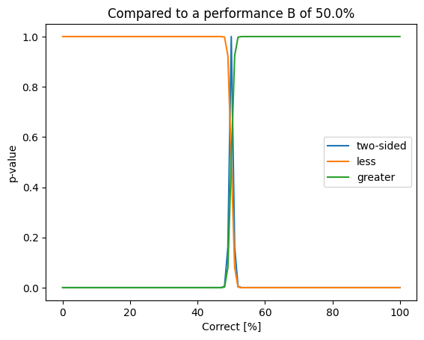
scipy.stats.fisher_exact
from scipy.stats
import fisher_exact
import numpy as np
import matplotlib.pyplot as plt
N: int = 10000
correct_b: int = N // 2
values = np.arange(0, N + 1, 100)
results_less = np.zeros((values.shape[0]))
for i in range(0, values.shape[0]):
correct_a: int = int(values[i])
res = fisher_exact(
[[N - correct_a, N - correct_b], [correct_a, correct_b]], alternative="less"
)
results_less[i] = res.pvalue

Slide 88
scipy.stats.fisher_exact
results_greater = np.zeros((values.shape[0]))
for i in range(0, values.shape[0]):
correct_a = int(values[i])
res = fisher_exact(
[[N - correct_a, N - correct_b], [correct_a, correct_b]], alternative="greater"
)
results_greater[i] = res.pvalue

Slide 89
scipy.stats.fisher_exact
results_two_sided = np.zeros((values.shape[0]))
for i in range(0, values.shape[0]):
correct_a = int(values[i])
res = fisher_exact(
[[N - correct_a, N - correct_b], [correct_a, correct_b]],
alternative="two-sided",
)
results_two_sided[i] = res.pvalue
plt.plot(100.0 * values / N, results_two_sided, label="two-sided")
plt.plot(100.0 * values / N, results_less, label="less")
plt.plot(100.0 * values / N, results_greater, label="greater")
plt.title(f"Compared to a performance B of {100.0 * correct_b /N}%")
plt.ylabel("p-value")
plt.xlabel("Correct [%]")
plt.legend()
plt.show()

Slide 90
Plotting weights

Slide 91
make_grid
torchvision.utils.make_grid(tensor: Union[Tensor, List[Tensor]], nrow: int = 8, padding: int = 2, normalize: bool = False, value_range: Optional[Tuple[int, int]] = None, scale_each: bool = False, pad_value: float = 0.0) → Tensor
Make a grid of images.

Slide 92
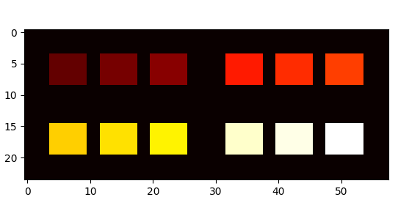
make_grid
import torchvision as tv # type: ignore
import torch
import matplotlib.pylab as plt
fake_weights = torch.zeros((3, 4, 5, 6))
for b in range(0, fake_weights.shape[0]):
for c in range(0, fake_weights.shape[1]):
fake_weights[b, c, ...] = 5 + b + c * 10
grid_image = tv.utils.make_grid(fake_weights, nrow=fake_weights.shape[0])
print(grid_image.shape) # torch.Size([4, 9, 26])
grid_image = tv.utils.make_grid(grid_image.unsqueeze(1), nrow=2)[0, ...]
print(grid_image.shape) # torch.Size([24, 58])
plt.imshow(grid_image, cmap="hot")
plt.show()
If dim channel = 1 goes in
dim channel = 3 comes out

